Slide 1
Skagit County Shoreline regulations
Planning Commission Workshop April 3, 2012

Slide 2
What is a shoreline area?
Shoreline Jurisdiction

Slide 3
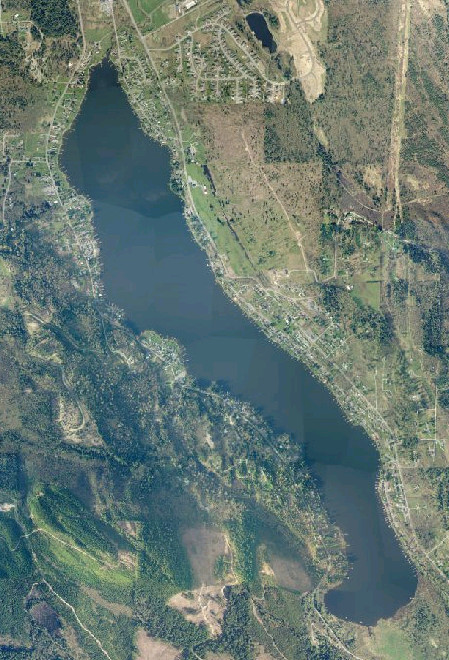
Lakes and reservoirs greater than 20 acres

Slide 4
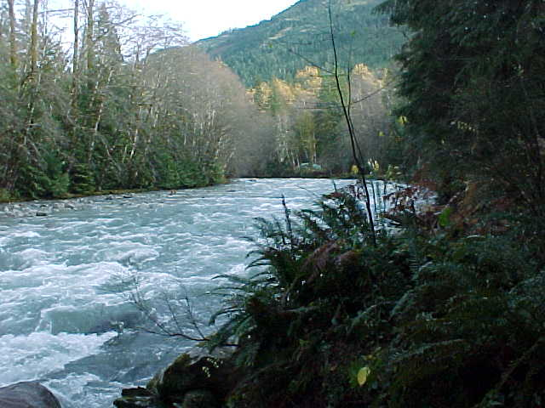
Rivers and streams with mean annual flow over 20 cfs

Slide 5
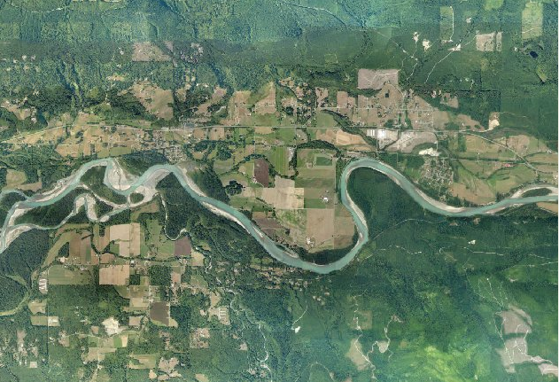
Lands extending 200 feet from the OHWM, floodways, floodways and floodplain areas 200 feet landward of the floodway

Slide 6
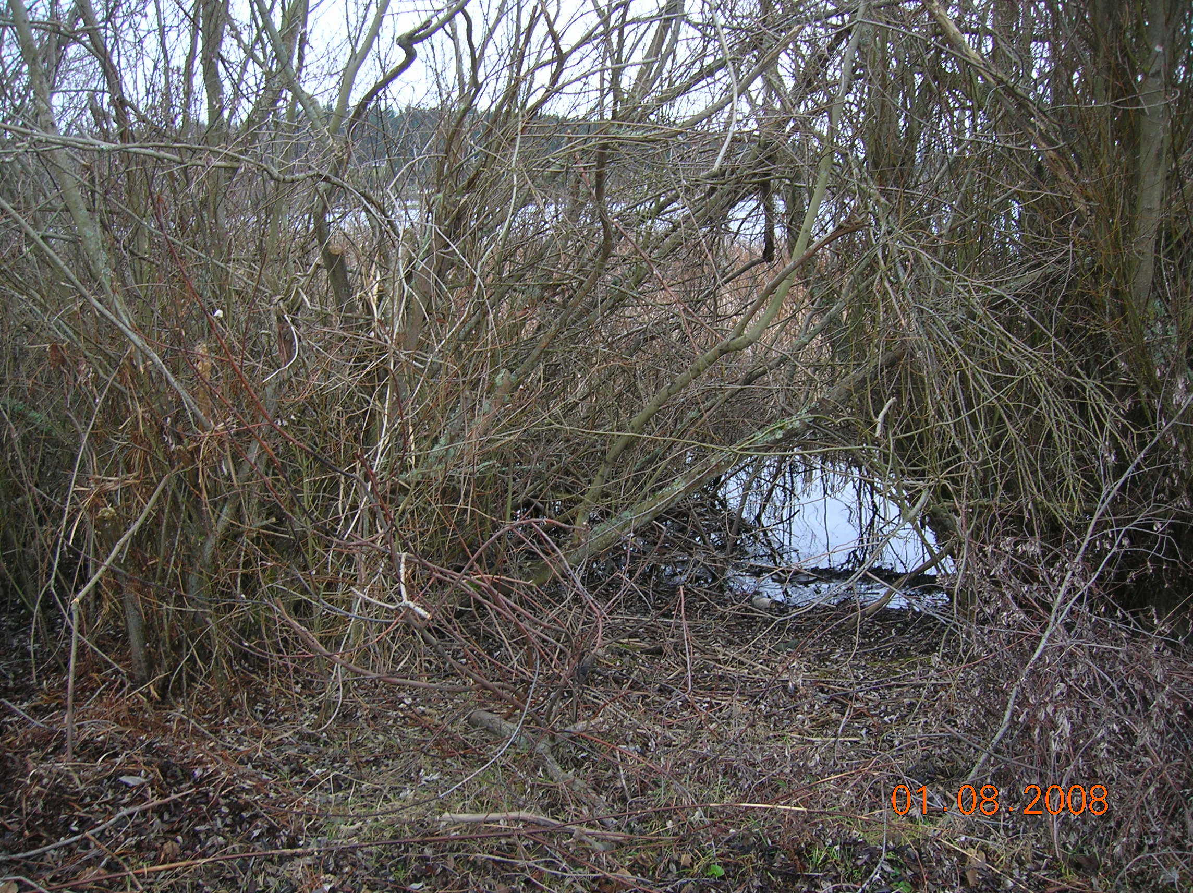
Associated wetlands

Slide 7
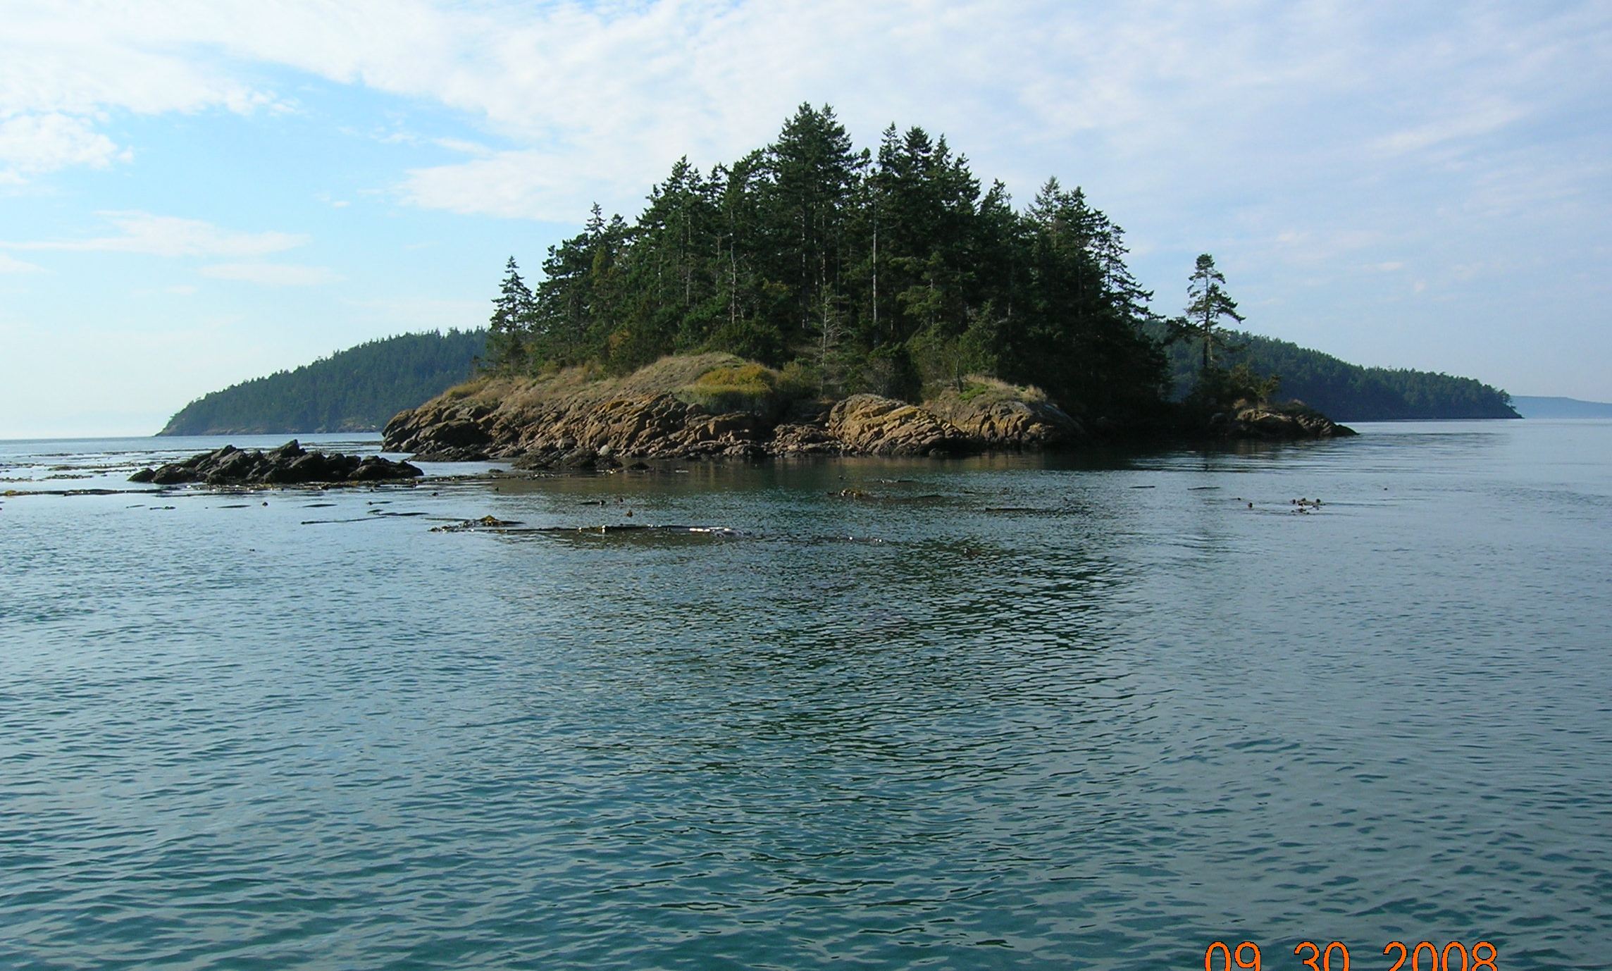
Marine shorelines

Slide 8
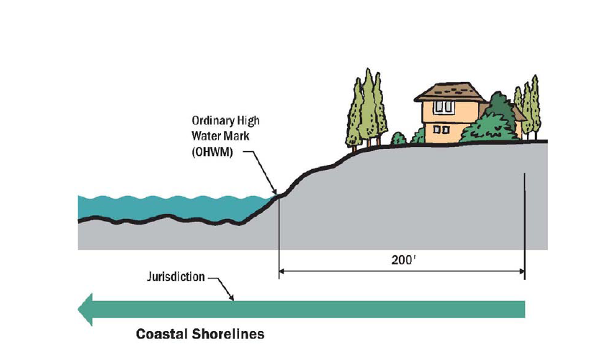
Shoreline jurisdiction for marine shoreline areas

Slide 9
What types of work may require a permit?
Residential Construction addition to an existing home accessory development
When is a permit necessary for residential activity?

Slide 10
Types of shoreline review
Exemption substantial Development conditional use variance
Shoreline Review Processes

Slide 11
Many residential activities are exempt from the substantial development permit requirements
Skagit County does have an application and review process for shoreline exemptions to ensure compliance with the local and state shoreline rules
Shoreline exemptions

Slide 12
Some examples of exempt Residential type activities include
Single family residence
Private dock
Protective shoreline armoring
Shoreline exemptions for residential development

Slide 13
What may trigger the need for a permit?
Work is substantial development
Work does not meet the requirements
Work is listed as conditional use
What may require a permit

Slide 14
Development -
A use consisting of construction or exterior alteration of structures; dredging; drilling; dumping; filling; removal of any sand, gravel or minerals; bulkheading; driving of piling; placing of obstructions; or any project of a permanent or temporary nature which interferes with the normal public use of the surface of the waters overlying lands subject to the Shoreline Management Act at any state or water level.
Definition of development

Slide 15
Substantial development –
Any development of which the total cost or fair market value exceeds $5,718,* or any development which materially interferes with the normal public use of the water or shorelines of the state.
This figure adjusted for inflation every five years by the OFM (July 1, 2012)
Definition of substantial development

Slide 16
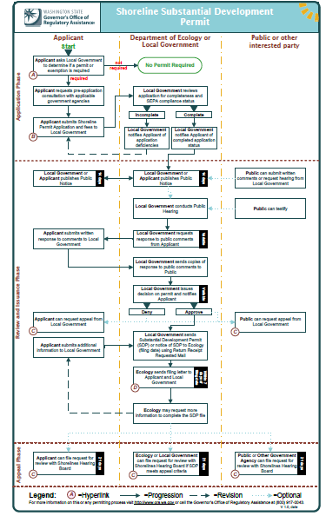
Permit process flow chart
Shoreline Substantial Development Permit Process

Slide 17
Shoreline variance permits
Most common for residential development
Usually for a reduction in the shoreline setback
Also for height or site coverage
Shoreline variances

Slide 18
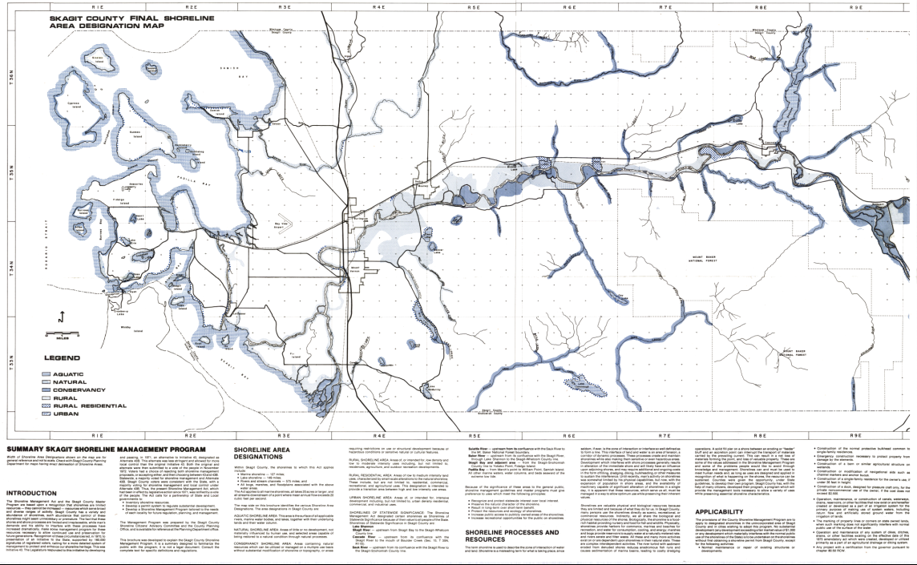
Skagit County Shoreline Area Designation Map

Slide 19
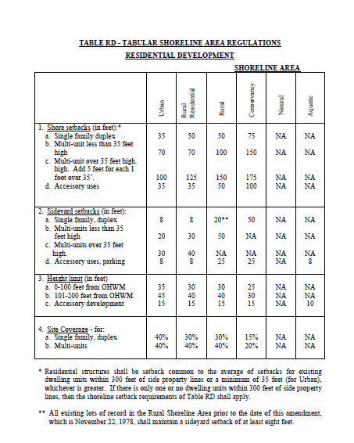
Tabular regulations for residential development
Shore setback, height limit, site coverage

Slide 20
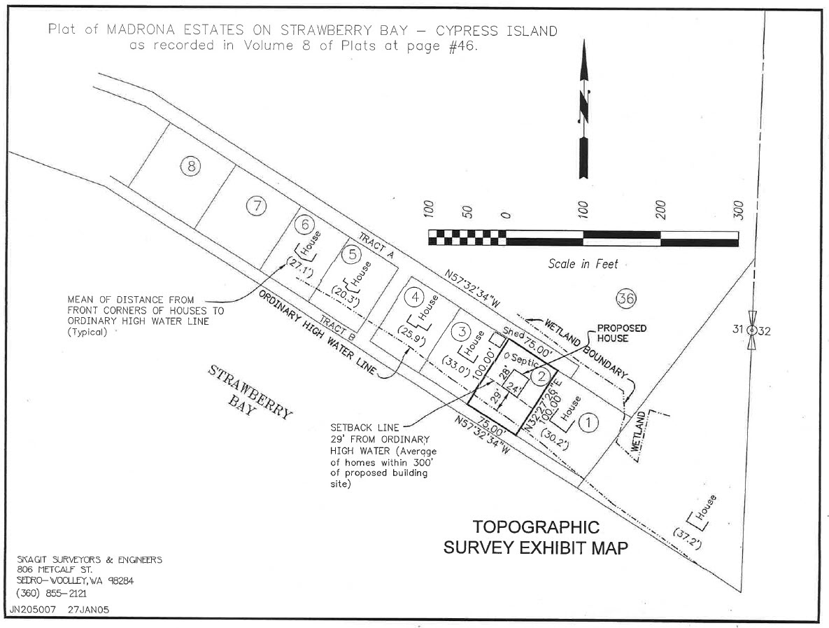
Shoreline setback determination
Determining shoreline setback using averages

Slide 21
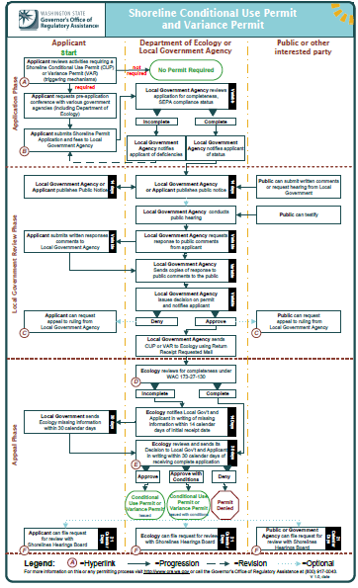
permit process flow chart
Shoreline Variance or Conditional Use Permit

Slide 22
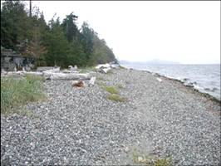
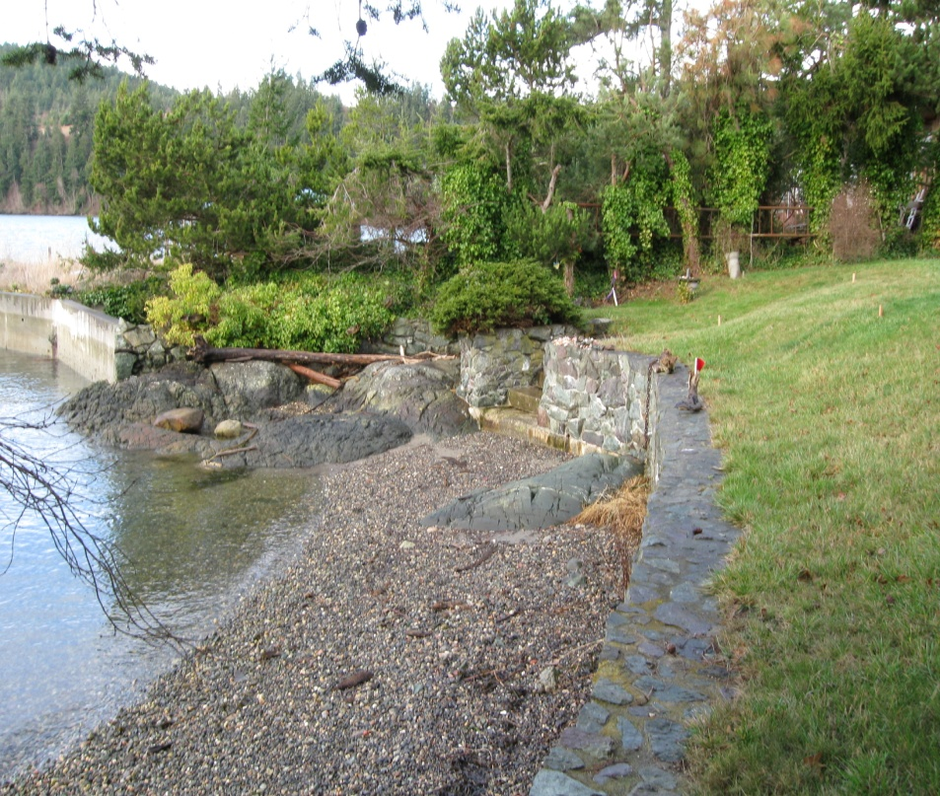
Shoreline and critical areas
Critical areas within shoreline areas

Slide 23
Shoreline areas are also critical areas
Critical area review is required
Critical area regulations apply
Critical area review in shoreline areas

Slide 24
Standard review process
Application
Staff completes map review
Staff conducts site visit
Site assessment prepared by a qualified professional
Protected Critical Area site plan
Critical areas review process

Slide 25
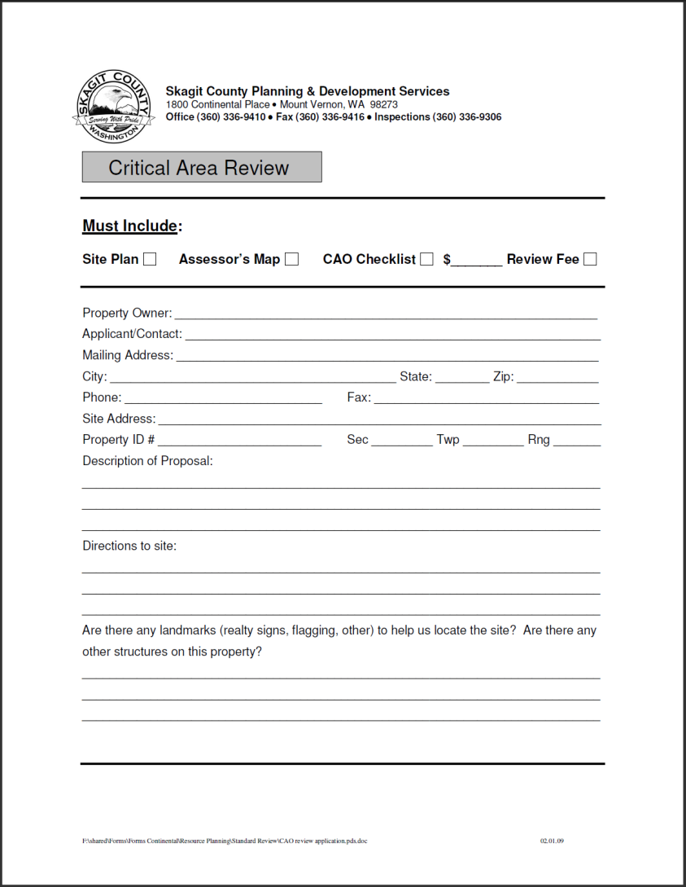
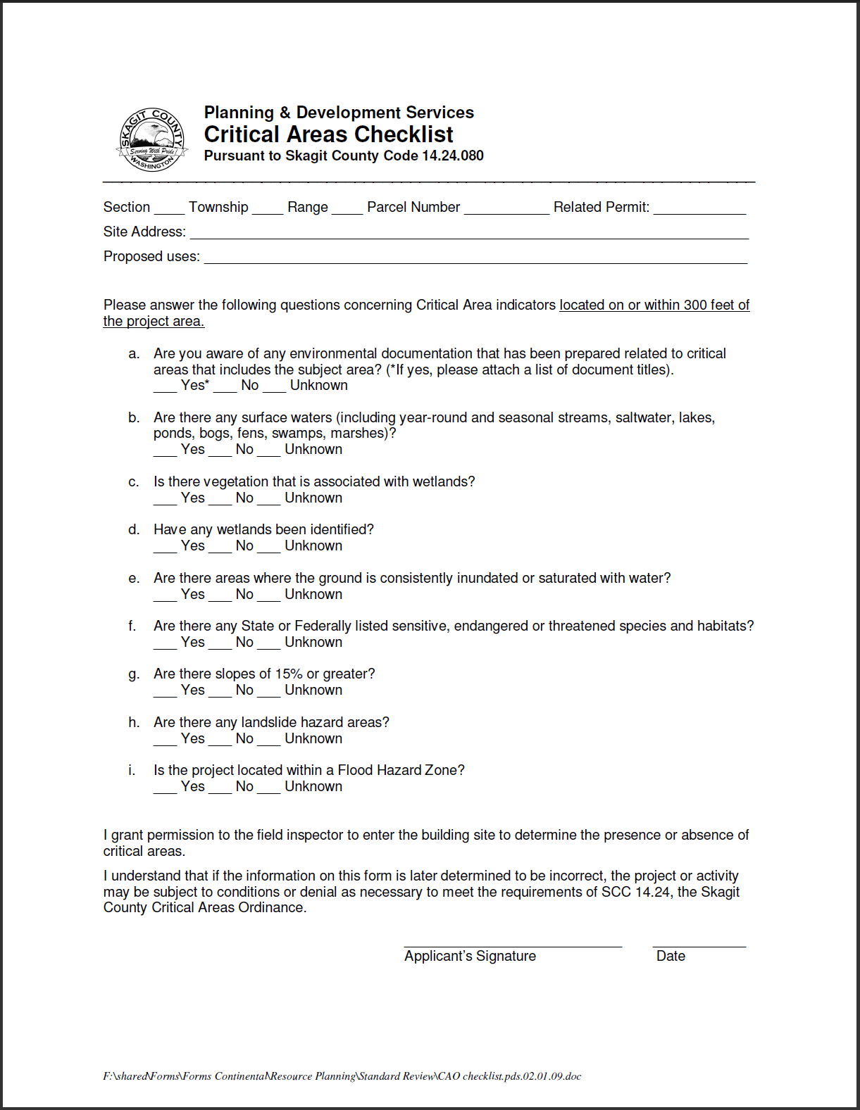
Standard review application
Critical areas review application

Slide 26
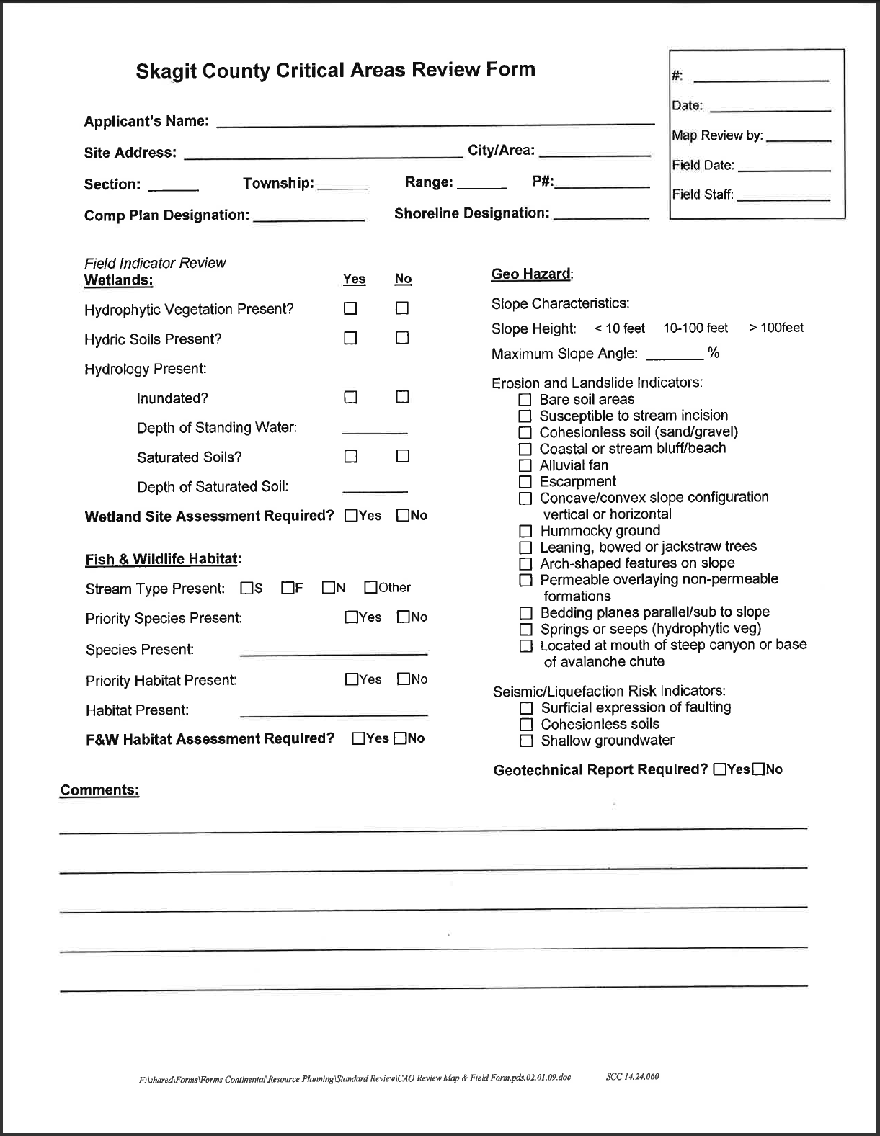
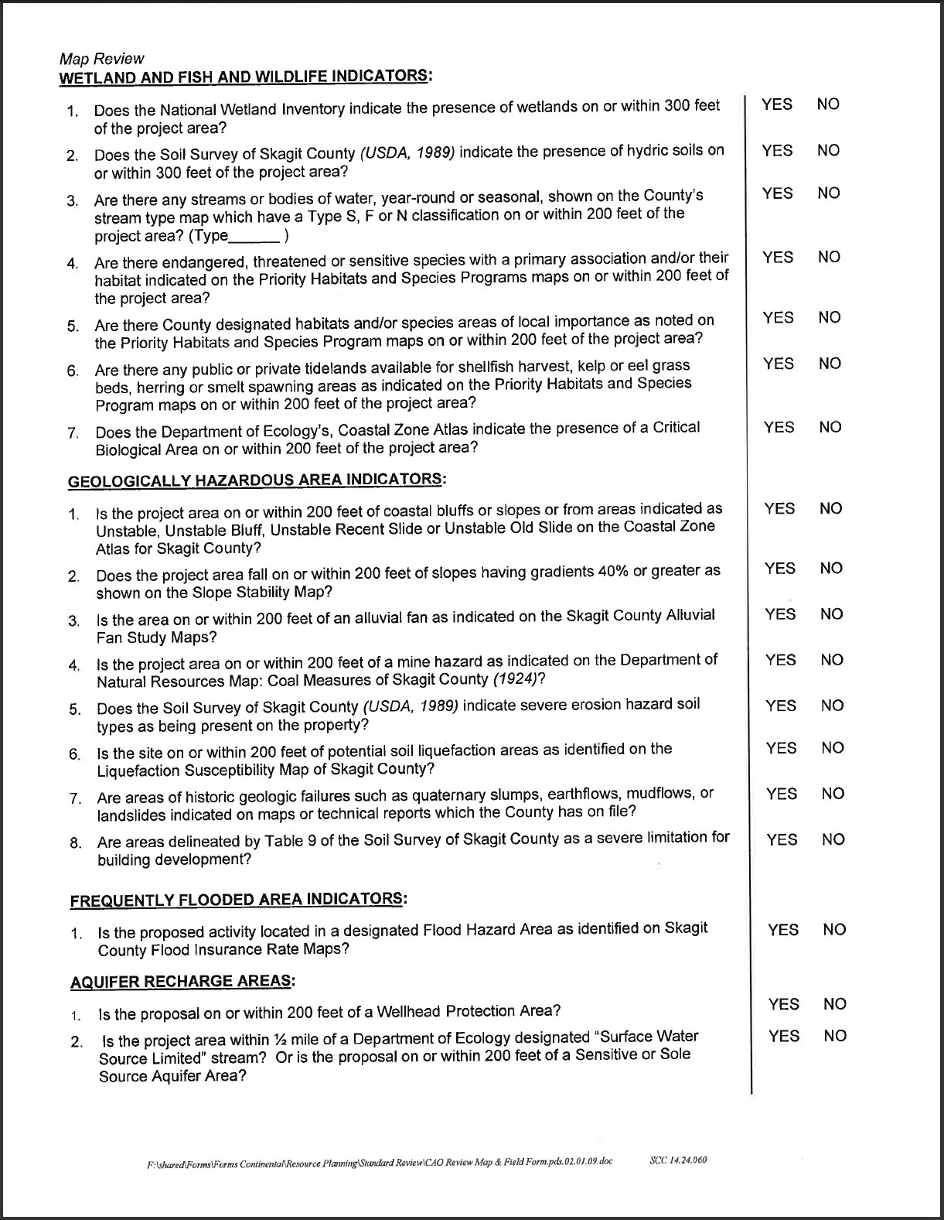
Map review and site visit
County staff critical areas review form

Slide 27
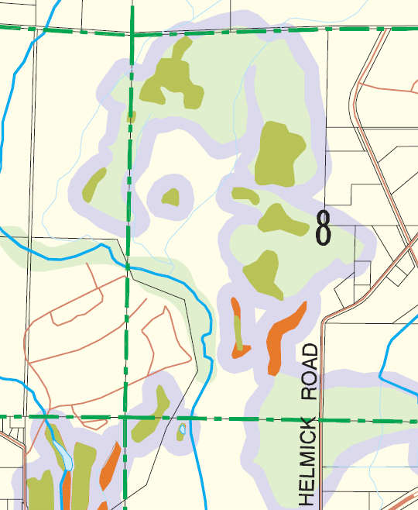
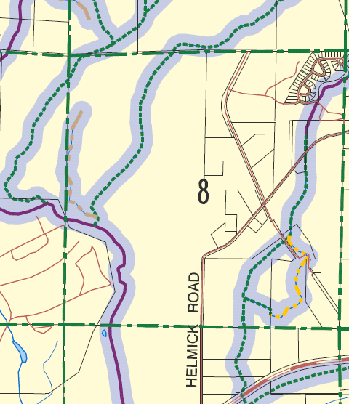
In-house map review
Wetlands/hydric soils DNR streams
Wetlands/hydric soils and DNR stream types maps

Slide 28
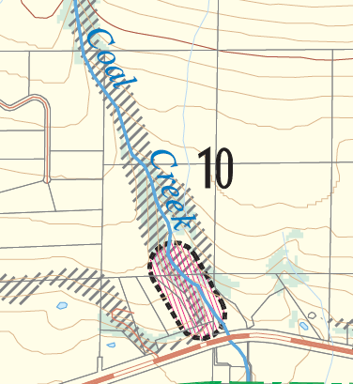
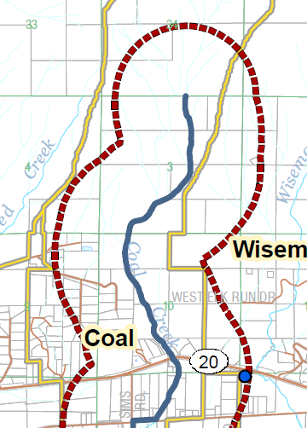
In-house map review
Geologic Hazards Aquifer recharge
Geologic hazards and Aquifer recharge maps

Slide 29
Lake and Marine shoreline buffers
Shoreline Area Designation | Shoreline Buffer
Natural | 200 feet
Conservancy | 150 feet
Rural | 100 feet
Rural Residential | 100 feet
Urban | 170 feet
Shoreline Area Designations and CAO Buffers

Slide 30
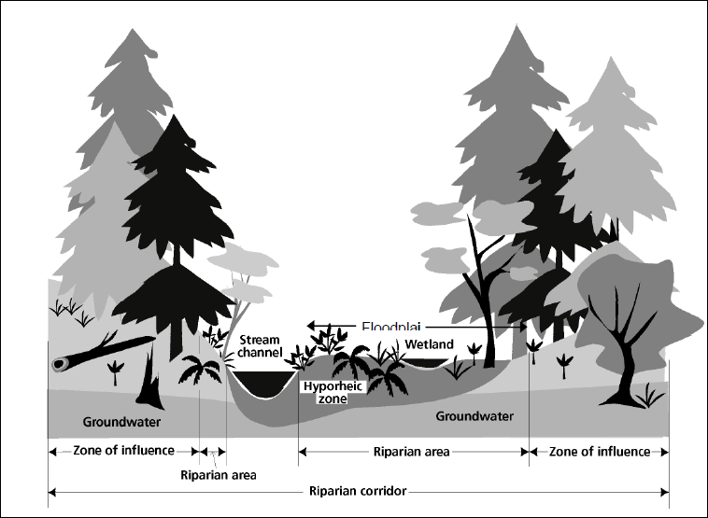
Streams that are shorelines
200 foot riparian buffer
Shoreline Streams and Existing CAO Buffers

Slide 31
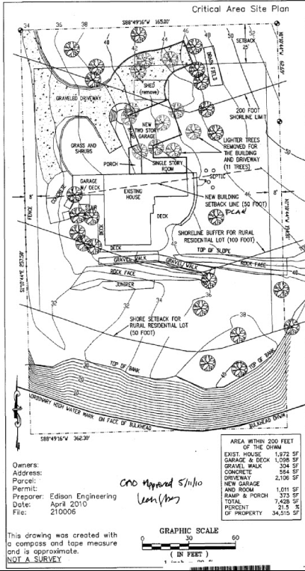
Shoreline and critical areas
Protected Critical Area (PCA) Plan
Example Protected Critical Area Site Plan

Slide 32
Shoreline master program update
Going on now
Regulations may be changing
Information is available at www.skagitcounty.net/SMP
Skagit County Shoreline Master Program Update

Slide 33
Element of the comprehensive plan development regulations environment designation maps
Content of the Master Program

Slide 34
Comprehensive Plan Element
Shoreline Uses and Modifications
Economic Development
Public Access
Recreation
Circulation
Conservation
Historic/Cultural/
Scientific/Educational
Flood Hazard Management
Restoration
Shoreline Process and
Administration

Slide 35
Development Regulations
Authority and Purpose
Shoreline Environment Designations
General Regulations
Administrative Provisions
Shoreline Use and Modifications
Critical Areas
Legal Pre-existing Uses and Structures

Slide 36
PUBLIC PARTICIPATION
Determine
Jurisdiction
Inventory
and
Analysis
SMP
Designation Map
Goals
Policies
Regulations
SMP Update Process

Slide 37
Restoration
Plan
Cumulative
Impact
Analysis
Local Adoption
Ongoing Public Participation
Ecology Review and Adoption
SMP Update Process

Slide 38
Advisory Committee meetings
June 14 and july 12 planning commission joint meeting with SAC may 22 work sessions June 5, 19 and july10, 24
Upcoming Schedule

Slide 39
Preliminary draft to ecology july 31 planning commission work sessions to review comments and make revisions – Sept, oct, nov hold public hearings – dec, jan * public open houses in october
* Dependent upon Ecology’s review schedule
Upcoming Schedule

Slide 40
submit draft smp, cumulative impacts analysis and restoration plan to ecology
November 31 planning commission and/or board of county commissioners consider ecology comments, revisions and local adoption february – june 2013
Upcoming Schedule

Slide 41
Thank you
For additional information, please contact Betsy Stevenson betsyds@co.skagit.wa.us
(360) 336-9410 ext 5879
Contact information

