Slide 1
Joint Work Session
Skagit County Planning Commission
and
Shoreline Advisory Committee
May 22, 2012

Slide 2
Work Session Topics
  Where are we in the SMP Process
  Review Draft Shoreline Analysis Report
  How is Analysis Report utilized
  Future steps of Planning Commission
  Review of draft Environment Designations

Slide 3
Status of SMP Process

Slide 4
WE ARE HERE
SMP
- Environment
Designations
- Goals
- Policies
- Regulations
Inventory
&
Analysis
Local Adoption
Cumulative Impacts Analysis
Determine Jurisdiction
Community Visioning
No Net Loss Standard
Restoration Plan
Public Participation
Ecology Review and Adoption

Slide 5
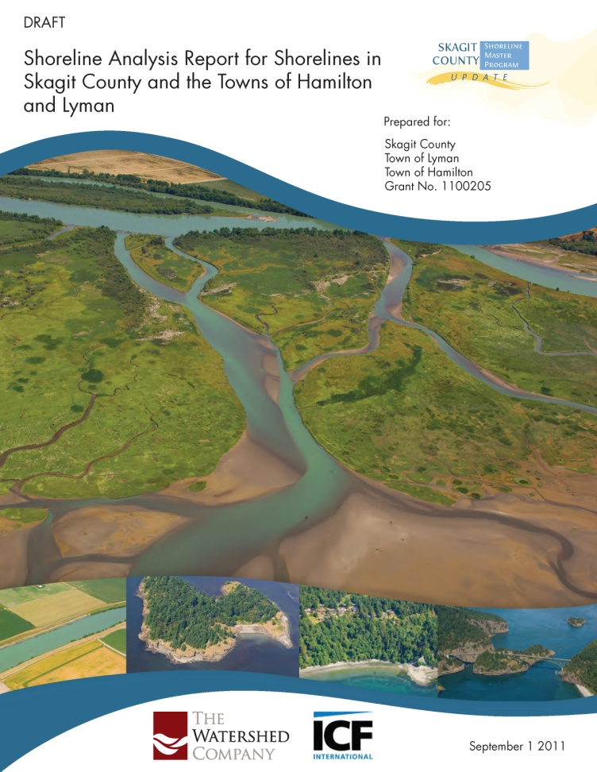
Development of the SMP
Builds upon:
  Community Visioning
  SMP Guidelines & Consistency Analysis
  Inventory/Analysis Report

Slide 6
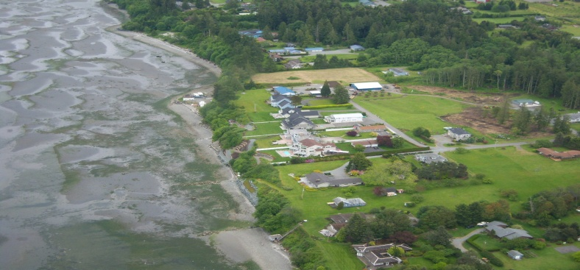
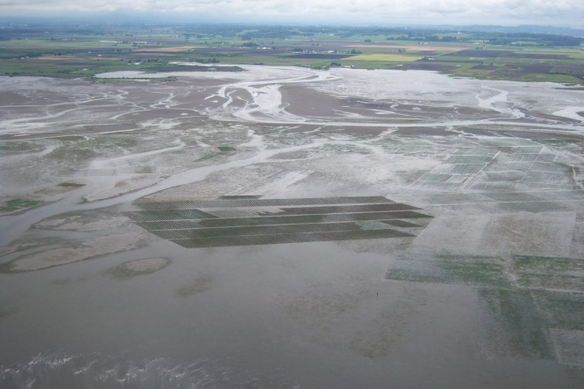
  Balance
    environmental protection
    public access
    water-oriented uses
    Still must:
  Protect Critical Areas
  Ensure No Net Loss of Ecological Functions
  Encourage preferred uses

Slide 7
Use of the Analysis Report

Slide 8
What does the Analysis Report do?
Inventories current baseline condition
Analyzes shoreline ecological functions
Analyzes current land use and future changes
Identifies restoration opportunities

Slide 9
How is it utilized?
Guides development of Environment Designations
Provides management recommendations for SMP issues
Starting point for future restoration plan
Provides linkage to SMP changes

Slide 10
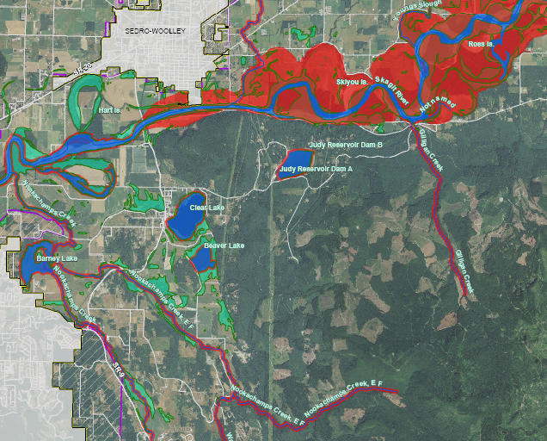
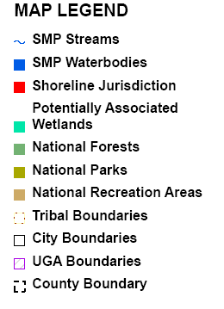
Preliminary Shoreline Jurisdiction
Notes:
Skagit County- diverse shoreline types (marine, estuarine, riverine, and lacustrine), diverse land use (residential centers, agricultural, forestry, public lands)

Slide 11
Inventory Elements
Geologic Hazards
Floodplains and Wetlands
Vegetation Coverage
Habitats and Species
Drift Cells
Shoreline Modifications
Water Quality
Environmental Cleanup Sites
Current Land Use
Land Ownership
Public Access
Septic Systems
Surface Water System
Impervious Surfaces
Geologic Units
Marine Shoreforms
Soils

Slide 12
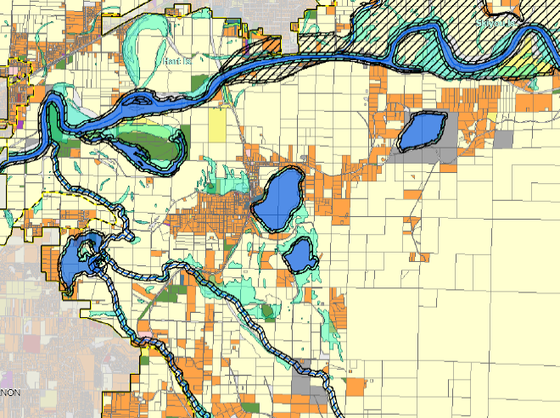
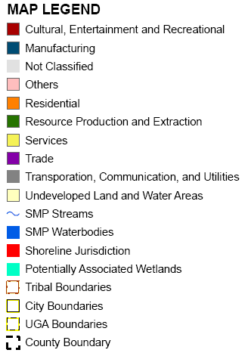

Slide 13
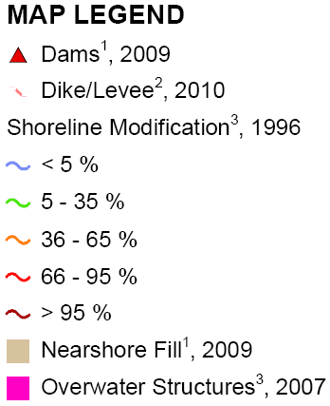
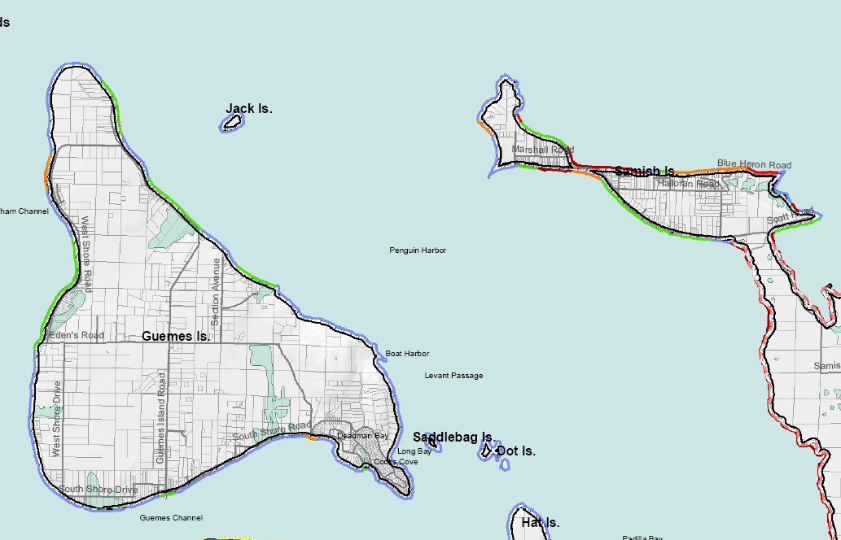

Slide 14
Management Units
Samish Bay
Samish Island, Padilla Bay, and East Swinomish Channel
Swinomish Tribal Reservation
Fidalgo Island and Other Islands
Skagit Bay/Delta
Lower Skagit River- Diking Districts
Samish River
Middle Skagit River
Upper Skagit River
Nooksack Watershed (WRIA 1)
Stillaguamish Watershed (WRIA 5)

Slide 15
Analysis of Ecological Functions
Broken down by shoreline reaches
Conduct qualitative and quantitative analysis of all shorelines within the County
Use existing studies to supplement county-wide analysis
Hydrologic, Hyporheic, Vegetative, Habitat

Slide 16
Evaluation of Ecological Functions
Category | Vegetation
 | Shade | LWD recruitment | Soil stabilization
Floodplain |  | x
Length of armoring |  | x
Tree/forest cover | x
Slope <15%
Soils – erodability |  |  | x
Vegetation - tree/shrub |  | x | x
Notes:
Go through a couple of examples
Rating (1-5) assigned to each value- based on scientific thresholds where possible, but generally on best professional judgment (fish bio, geomorphologist)

Slide 17
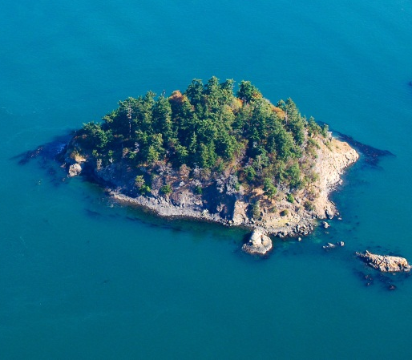
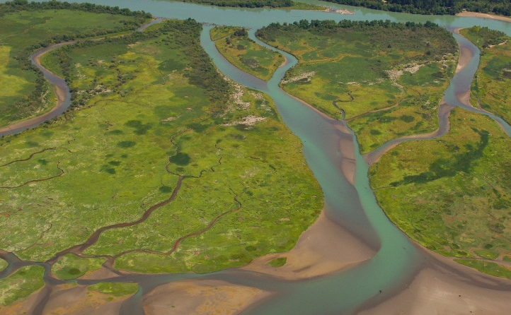
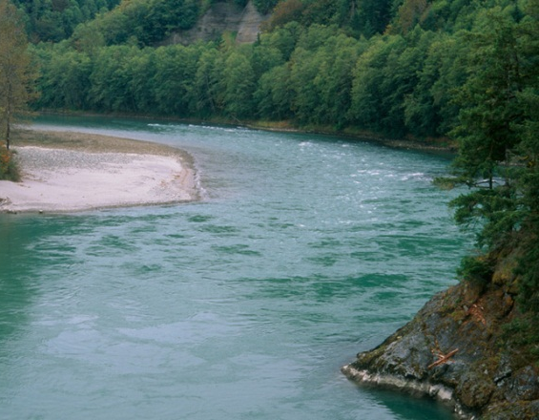
What scores provide:
Quantitative, objective evaluation of relative functions within reaches and management units
What scores are not:
Absolute metric of ecological function
Notes:
Scores provide a meaningful comparison of functions within geomorphically similar areas. Scores are not as useful comparing sites across the management units (i.e. not meaningful to compare the condition of an estuarine site with the condition of a glacial lake, or a large river floodplain with a confined upper elevation tributary. We recognize that underlying conditions (soils, hydrology) may be so distinct that functional scores will not be comparable.

Slide 18
General Findings
Functional scores generally consistent with intuitive weighting and past site specific studies
Functions related to:
    Land use
    Forest cover
    Armoring
    Overwater coverage (marine and lakes)
    Land ownership (public/private)

Slide 19
Land Use Analysis
Gauge potential development given existing conditions and regulations
Data and assumptions consistent with Envision Skagit County 2060 model where possible
2 analyses- 1 for rural, 1 for urban
Calculated net change in residential development and number of new employees (industrial/commercial development)
Notes:
Useful to gauge overall trends, not to identify site specific areas where development will occur

Slide 20
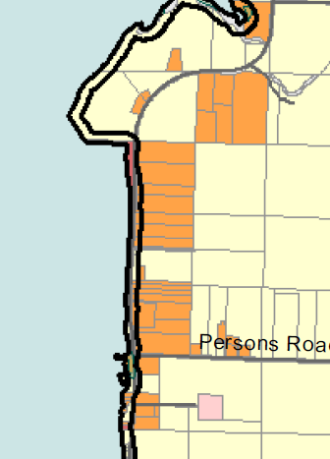
Total Land / Zoning density
- Developed land
- Infrastructure
- Land in floodway
- Lands in Conservation
- Development factor
Total Developable Area
Notes:
Development factor depends on whether property is vacant, underutilized.
Critical area acreage was not deducted because Skagit County code uses Gross developable area. TDRs could be used to transfer development out of floodplain.

Slide 21
Public Access
-Incorporated 2003 survey of County Parks and Rec needs
-Findings: Demand for regional parks, boat ramps, and freshwater access
-Review of needs
- Trails
Street Ends
Land NGOs
Parks and Rec Easements
Water trails

Slide 22
Future steps for PC

Slide 23
Review of Working Draft SMP
Environment Designations
General Upland and Aquatic
General Provisions
  (public access, flood hazards, vegetation conservation)
Shoreline Uses
  (residential, commercial, mining, aquaculture, etc.)
Shoreline Modifications
  (armoring, boating facilities, fill, dredging, etc.)

Slide 24
Potential Meeting Topics
June 5th:
Environment Designations
Vegetation Conservation
Shoreline Stabilization
Dredging
July 10th:
Critical Areas
Aquaculture
In-Stream Structures
Fill/Excavation
June 19th:
Public Access
Residential
Agriculture
Forest Practices
July 24th:
Boating Facilities
Non-Conforming Uses/Struct.
Administrative Provisions
Commercial Uses

Slide 25
Draft Environment Designations

Slide 26
Key Issues
1. Environment Designations are to be based on land use AND ecological conditions
2. Are there unique areas in the County that deserve unique designations?
3. Current level of mapping is extremely poor

Slide 27
Comparison
Existing Designations | Proposed Designations
Aquatic | Aquatic
Natural | Natural
Conservancy | Conservancy – Skagit Floodway
Rural | Rural Conservancy
Rural Residential | Shoreline Residential
Urban | High Intensity
 | Urban Conservancy - Towns

Slide 28
Environment Designation Development
Starting Point
Areas waterward of the OHWM were designated Aquatic
Large blocks of Federal land = Natural
High density residential = Shoreline Residential
Areas of more intense development = High Intensity
Areas of high ecological function = Natural
All remaining areas = Rural Conservancy
Made consistent with tribal designations

Slide 29
Environment Designation Development
Adjustments
Some parcels zoned OSRSI were designated Natural
Some other public parcels were designated Natural
Some high functioning parcels were adjusted due to underlying land use (e.g. residential)
Some areas of private ownership in Federal blocks were adjusted to Rural Conservancy
Skagit River floodway in middle Skagit given unique designation: Conservancy – Skagit Floodway

Slide 30
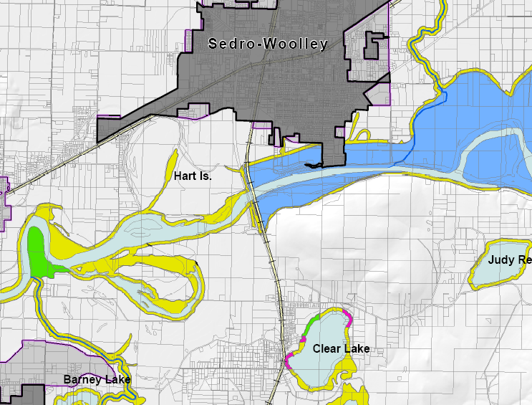
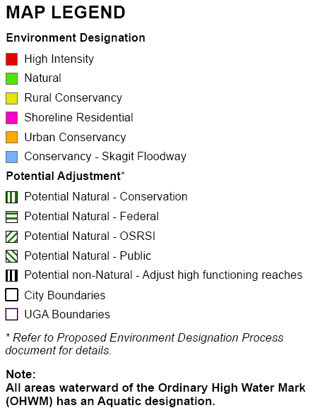

Slide 31
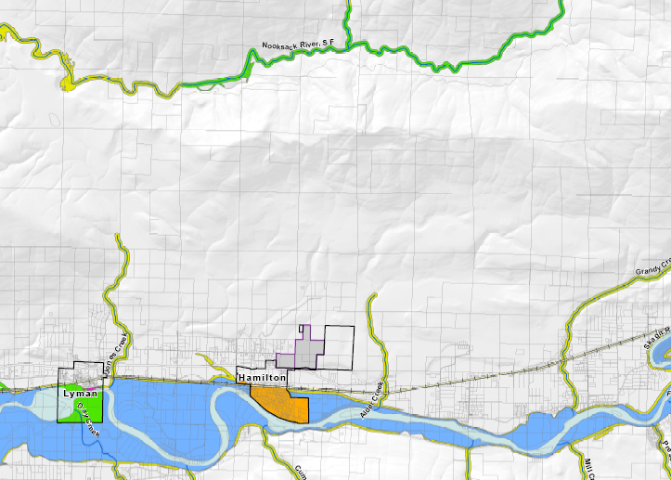

Slide 32
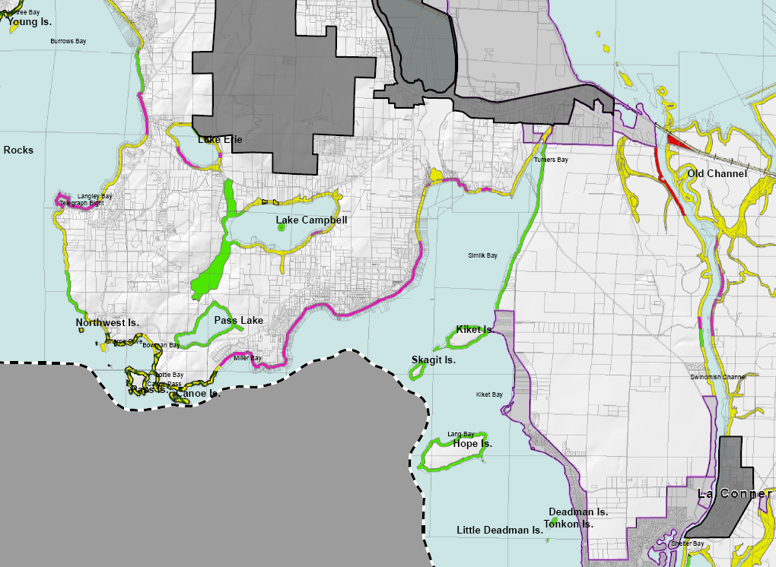

Slide 33
Shoreline Visioning Summary

