Slide 1
Yakima County
Department
Of
Corrections

Slide 2
Skagit County Jail Coordinating Council Members,
In order to help you during these tough economic times, we are offering discounted beds for rent.
The Yakima County Department of Corrections currently has empty jail beds that we are looking to fill. We offer transportation that is included in our low rate, and there are no booking fees. We are dedicated to helping you maintain and control any overflow of prisoners you may be currently faced with. This, in turn, prevents the potential of early release due to overcrowding, which is of greatest value to the criminal justice system and the communities we all respectively serve.
Upon review, you will see that your jurisdiction can save a substantial amount of money by contracting with Yakima County.
Respectfully,
Director Ed Campbell

Slide 3
History of Facilities
Main Facility built in 1984
Maximum capacity of Main Facility is 535
Indirect supervision housing units
Annex Facility built in 1993
Maximum capacity of Annex Facility is 411
Indirect supervision housing units
Yakima County Correctional Center(YCCC) built in 2007
Maximum capacity of YCCC is 288
Direct supervision housing units

Slide 4
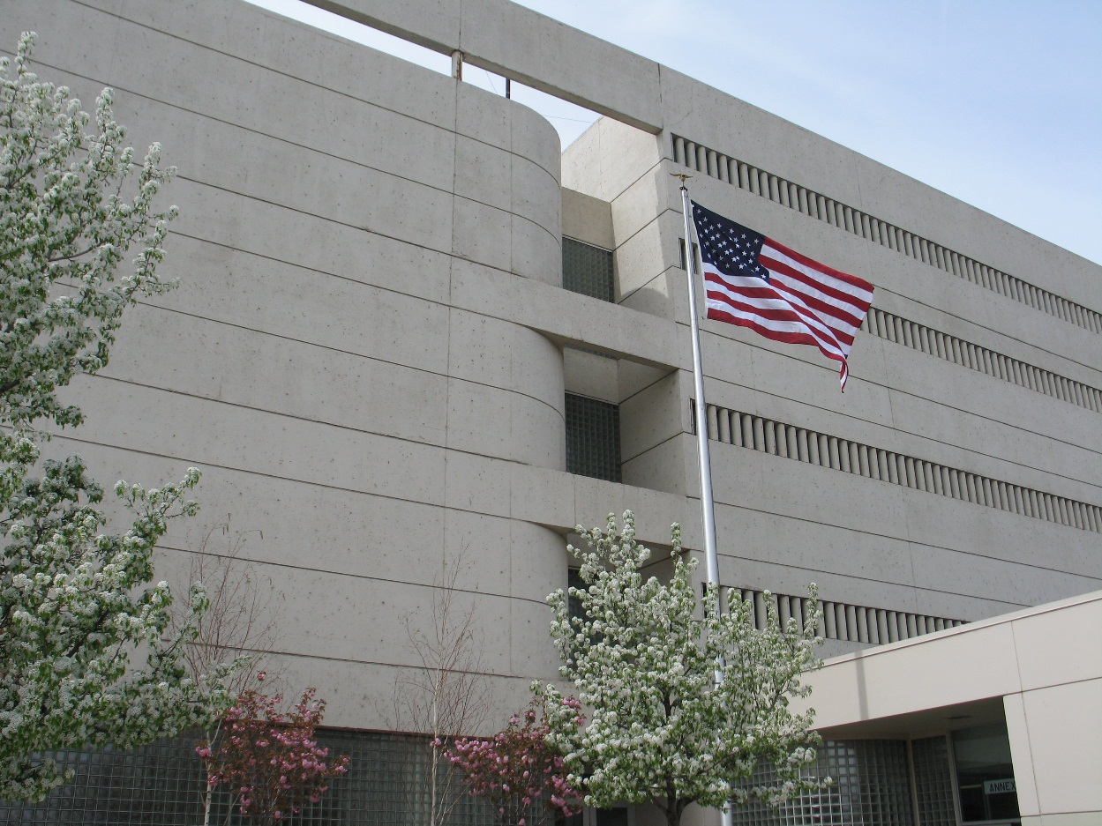
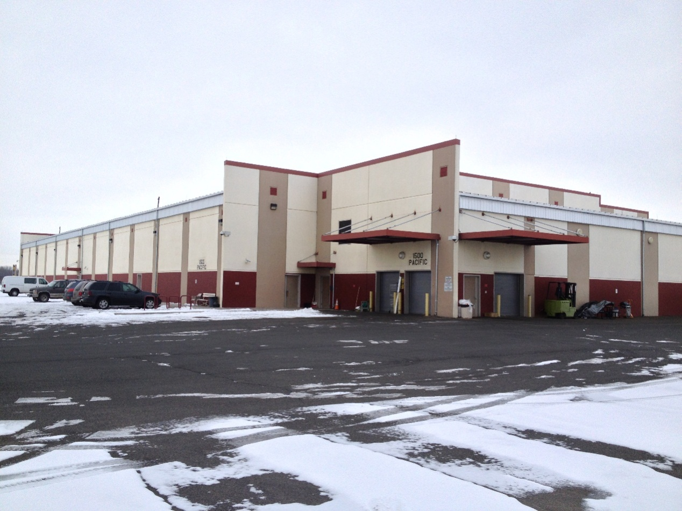
Our Facilities
Main Facility and Annex
Yakima County Correctional Center

Slide 5
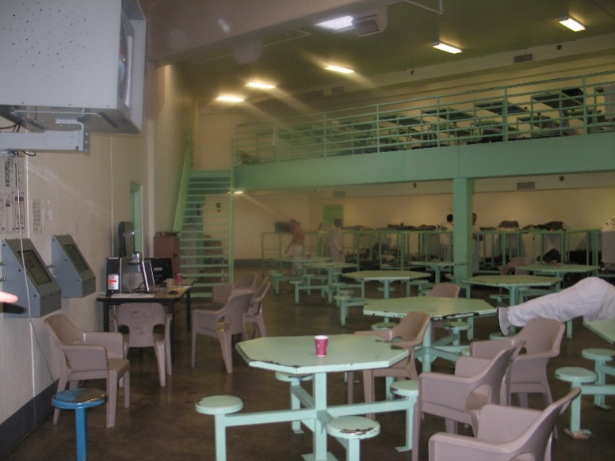
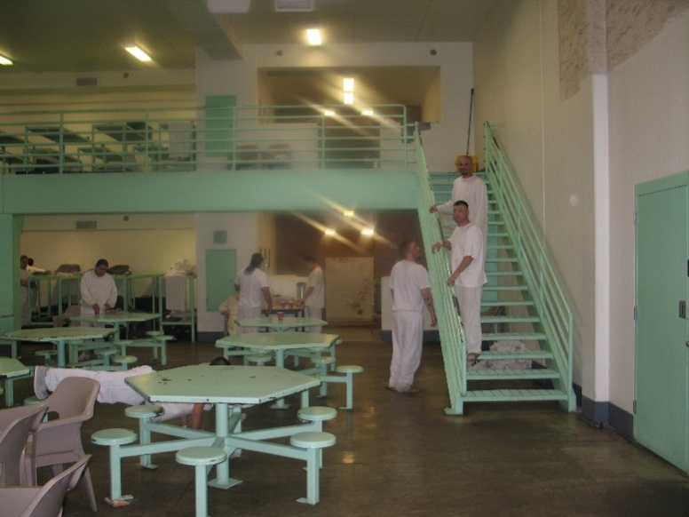
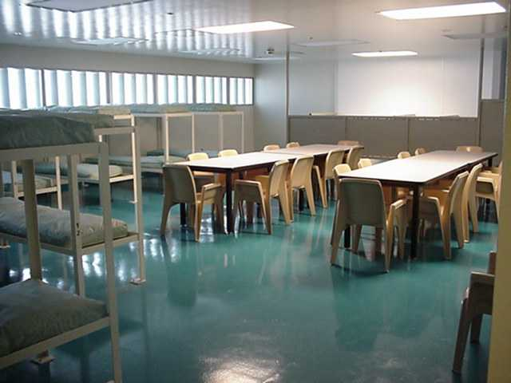
Main Facility and Annex
Annex Housing Unit
Main Jail Housing Unit

Slide 6
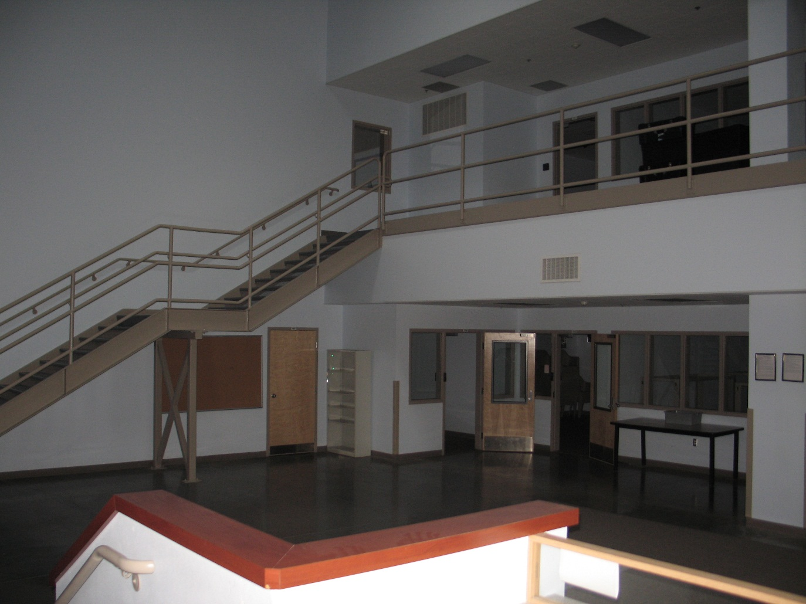
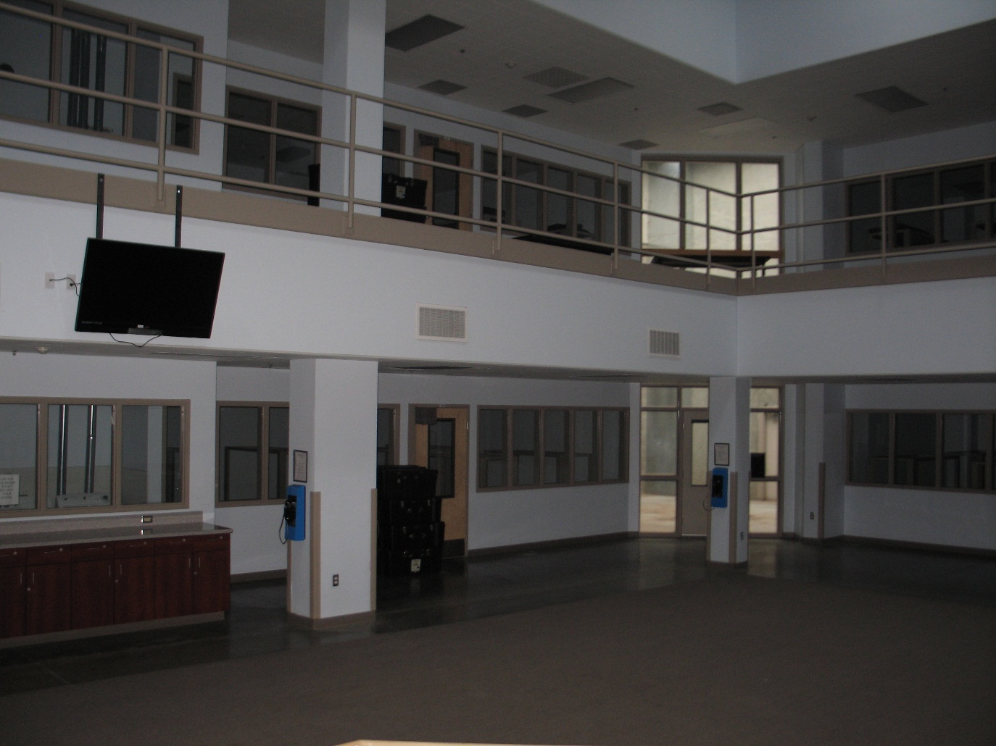
Yakima County Correctional Center

Slide 7
Video Visiting
Moved to Video Visiting instead of Face to face visits for all inmates in November, 2008
Built and moved the video visiting center across the parking lot of the main facility in October, 2012
All visits are scheduled through our clerical staff at least one day in advance.
There are 28 booths for the public to visit from at the Video Visiting Center.
Inmates use visiting booths in their housing units if housed in the
Annex or at the YCCC
If inmates are housed in the Main Facility they visit in private visiting booths on the same floor they are housed.

Slide 8
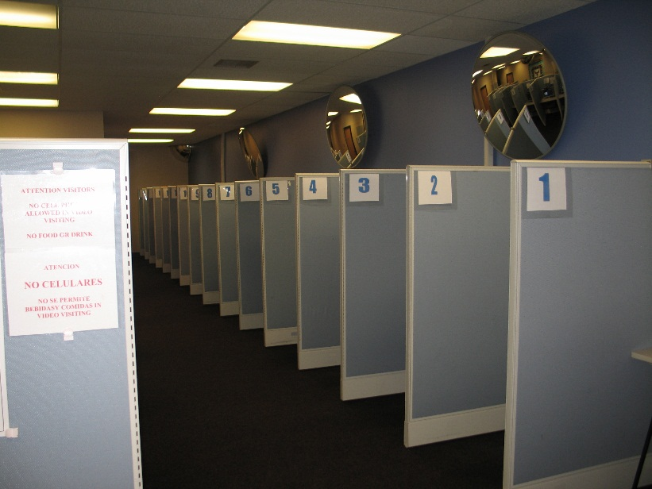
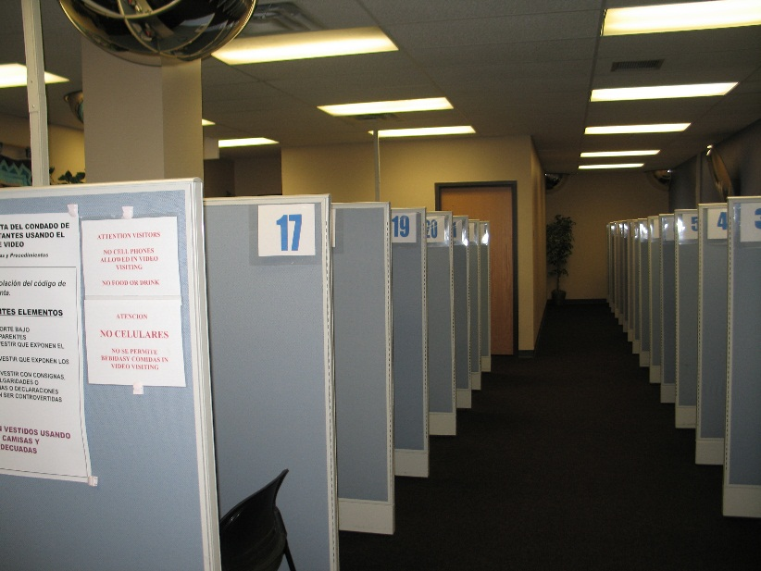
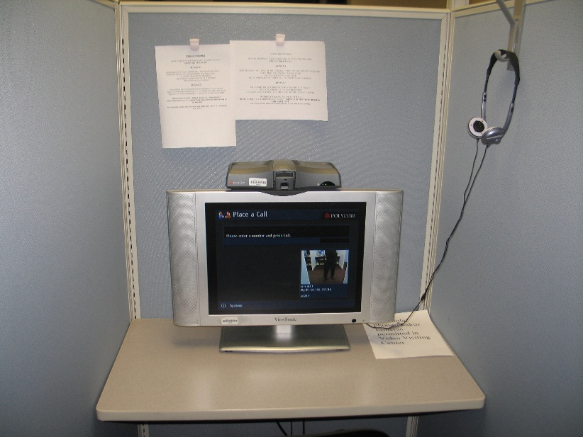
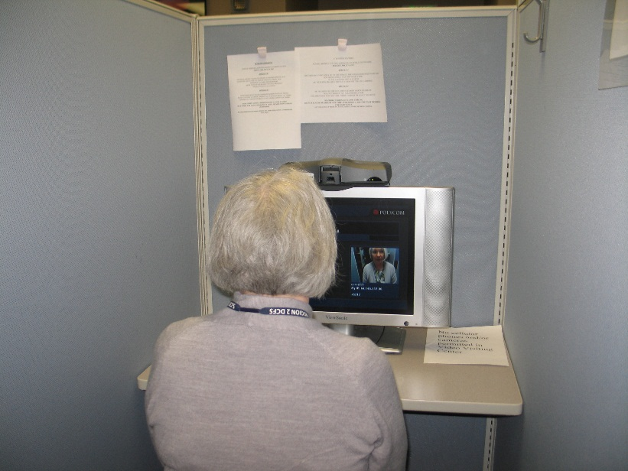
Video Visiting Center

Slide 9
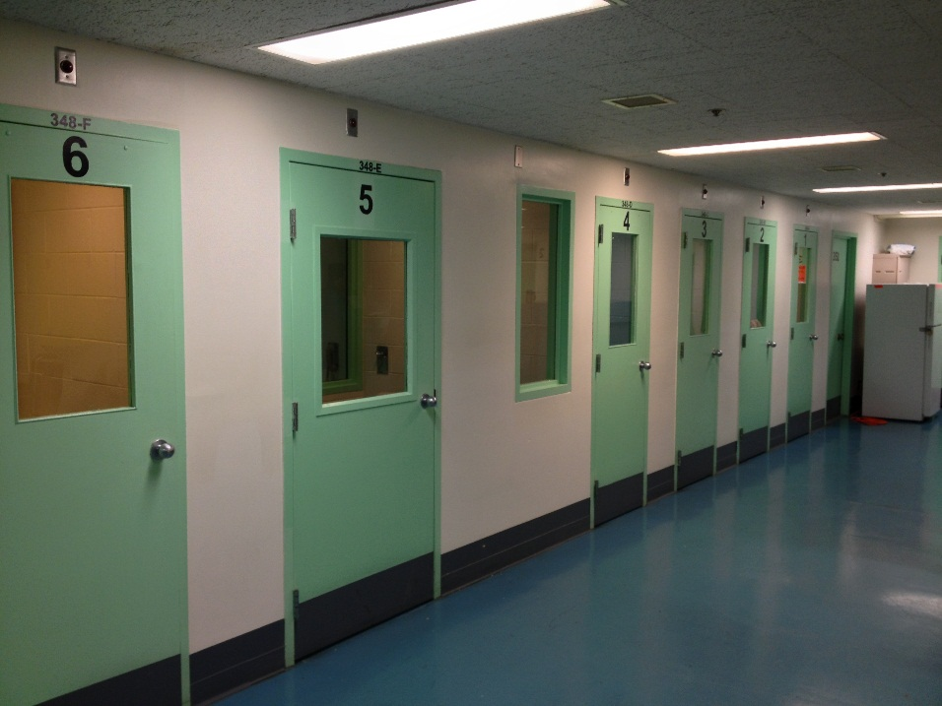
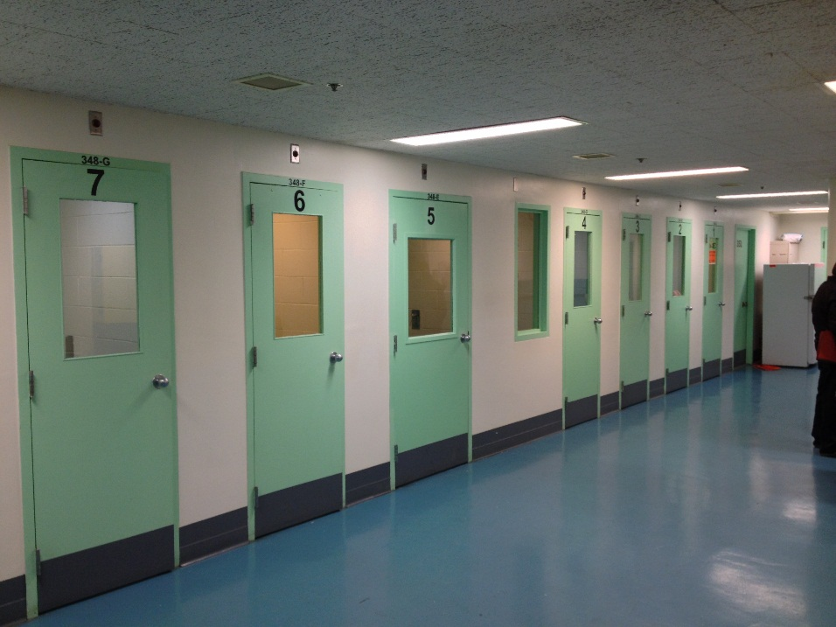
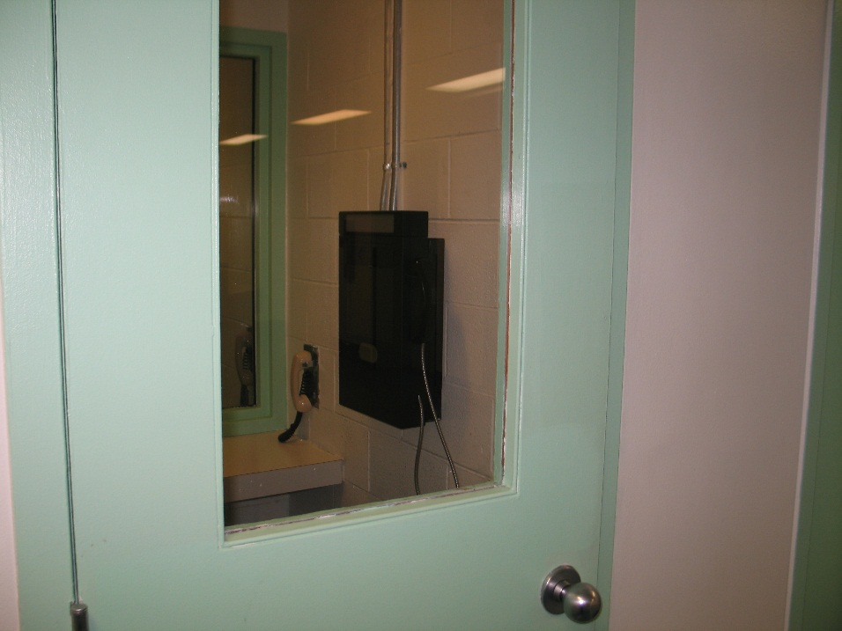
Video Visiting

Slide 10
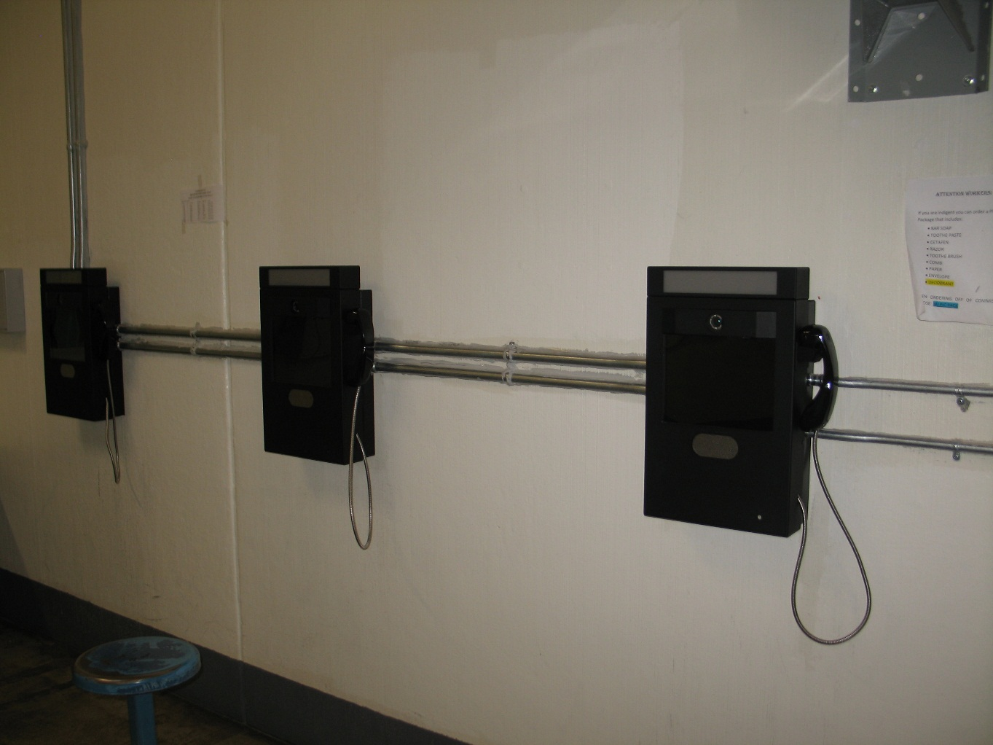
Video Visiting

Slide 11
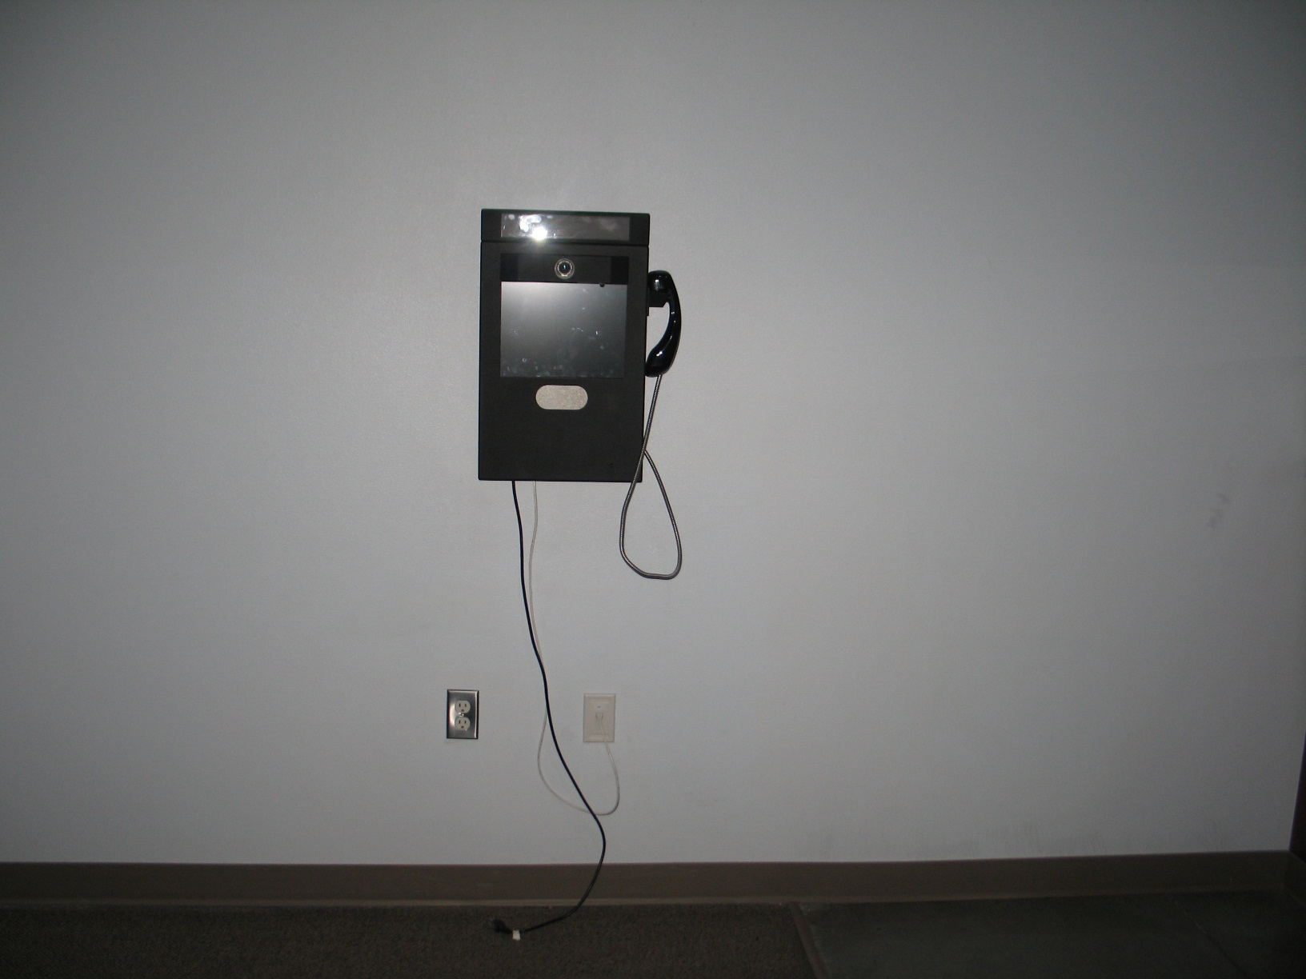
Video Visiting

Slide 12
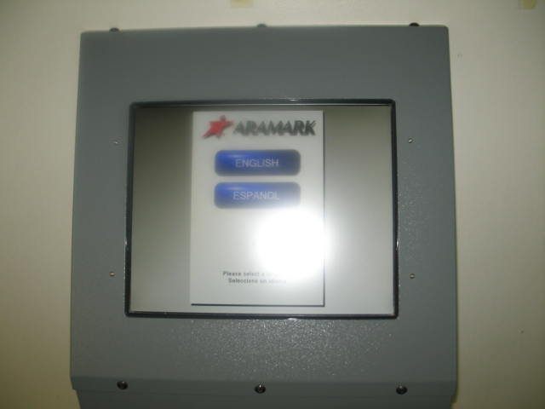
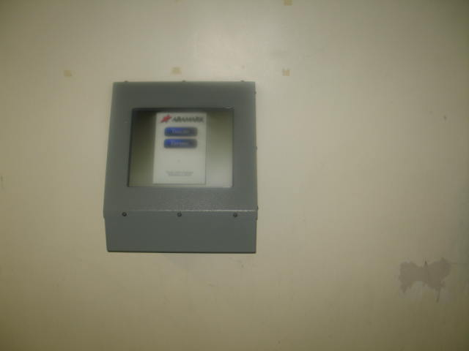
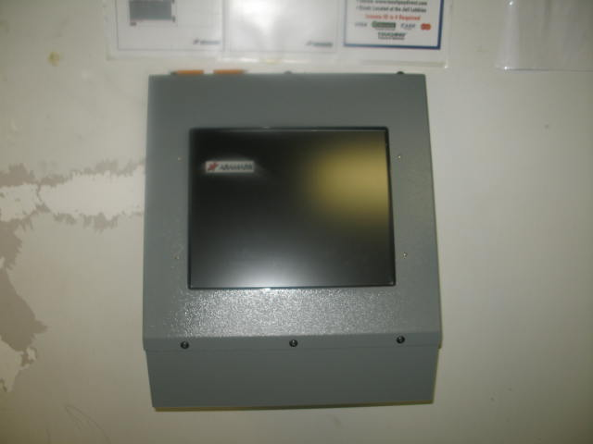
Inmate Kiosks
Used for ordering commissary
Filling out Kites and seeing responses
Filling out Grievances and seeing responses
Reading Inmate Handbook

Slide 13
Inmate Programs
Alcoholics Anonymous
Strong Families
Biblical Life Principles Unit – Both Male and Female
Barber – Visits two times a month, no cost to inmates
HIV education classes
HIV testing
Home Detention
Inmate Worker
Veterans Incarcerated Program
Sewing – inmate workers repair torn clothing items
Gang Renunciation
Sunday Religious Services
Non-Denominational
Native American

Slide 14
Inmate Programs
Financial Wellness Classes
Food Handler Classes with Test (inmates receive a food handlers card)
Forklift Classes (Inmates must qualify to be an outside worker to take these classes)
Flagging Classes (Inmates must qualify to be an outside worker to take these classes)
GED
Getting it Right Program
Making it Work Program
Managing Self-defeating Behaviors (MSDB)
Moral Recognition Therapy (MRT)
Prevention Awareness
Gardening – Outside inmate workers grow a vegetable garden and flower beds
Communication and Behavior Program (CAB)
Making Quilts
Work Ethic Detention Program (WED) – work release

Slide 15
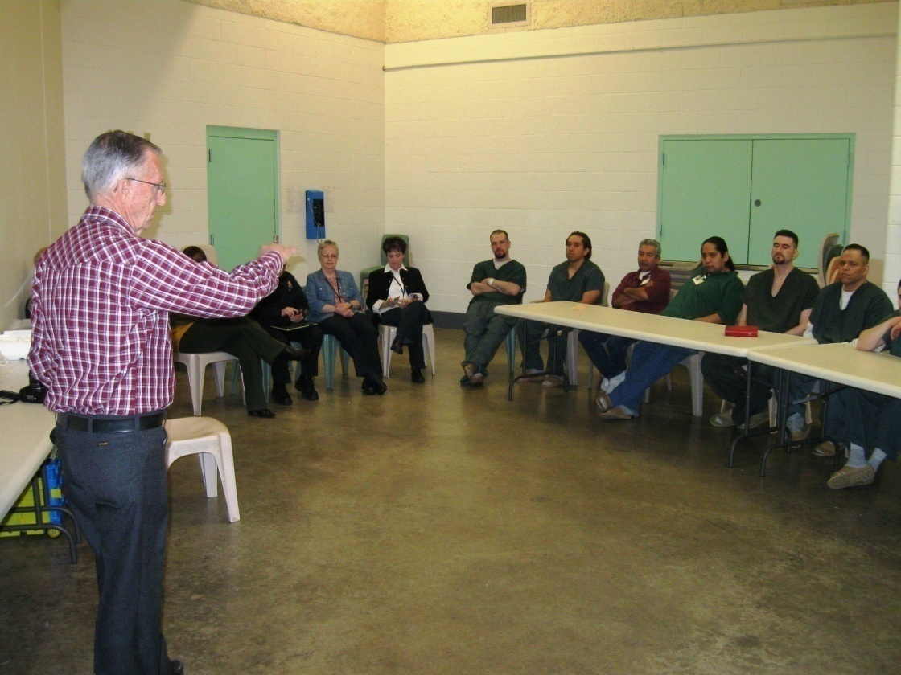
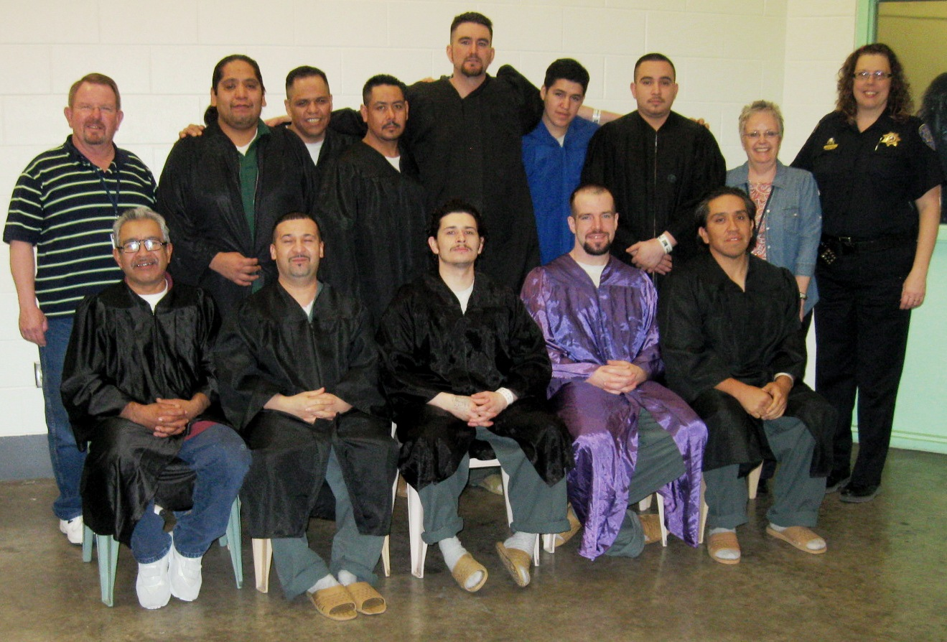
Inmate Programs Continued
Strong Families

Slide 16
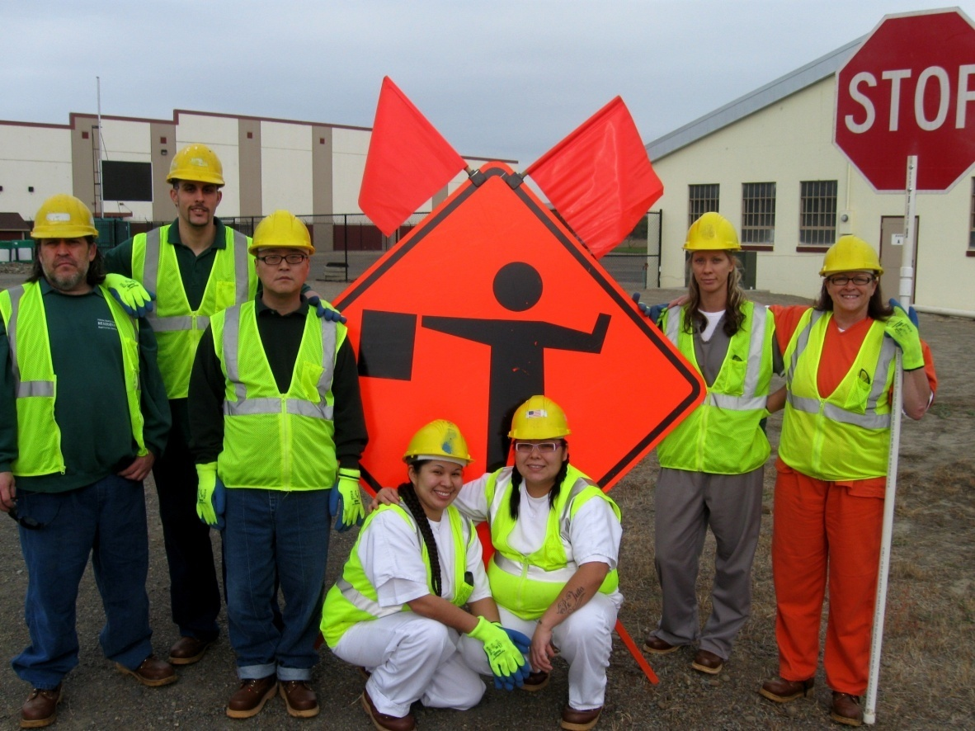
Inmate Programs Continued
Flagging Classes (Inmates must qualify to be an outside worker
to take these classes)

Slide 17
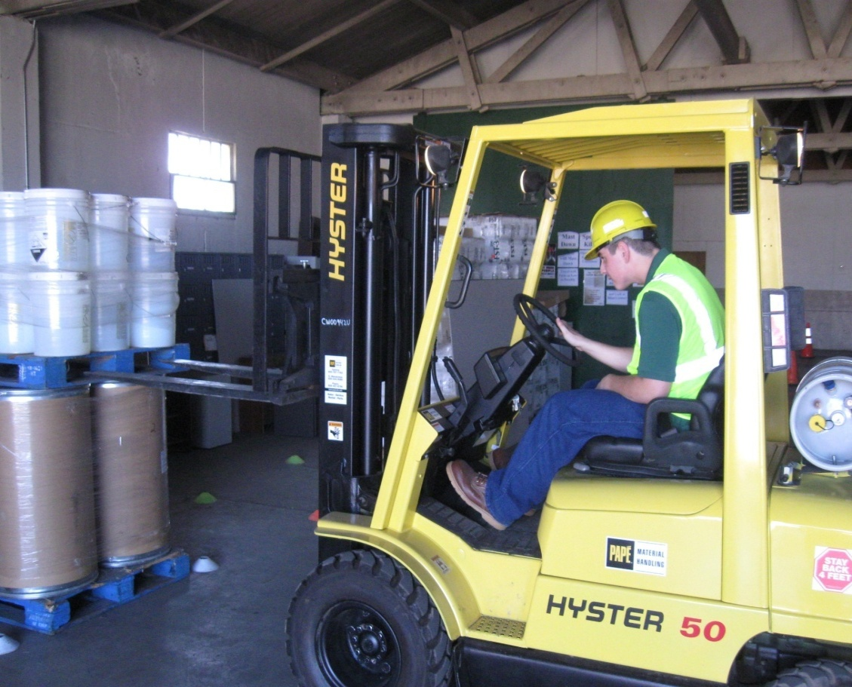
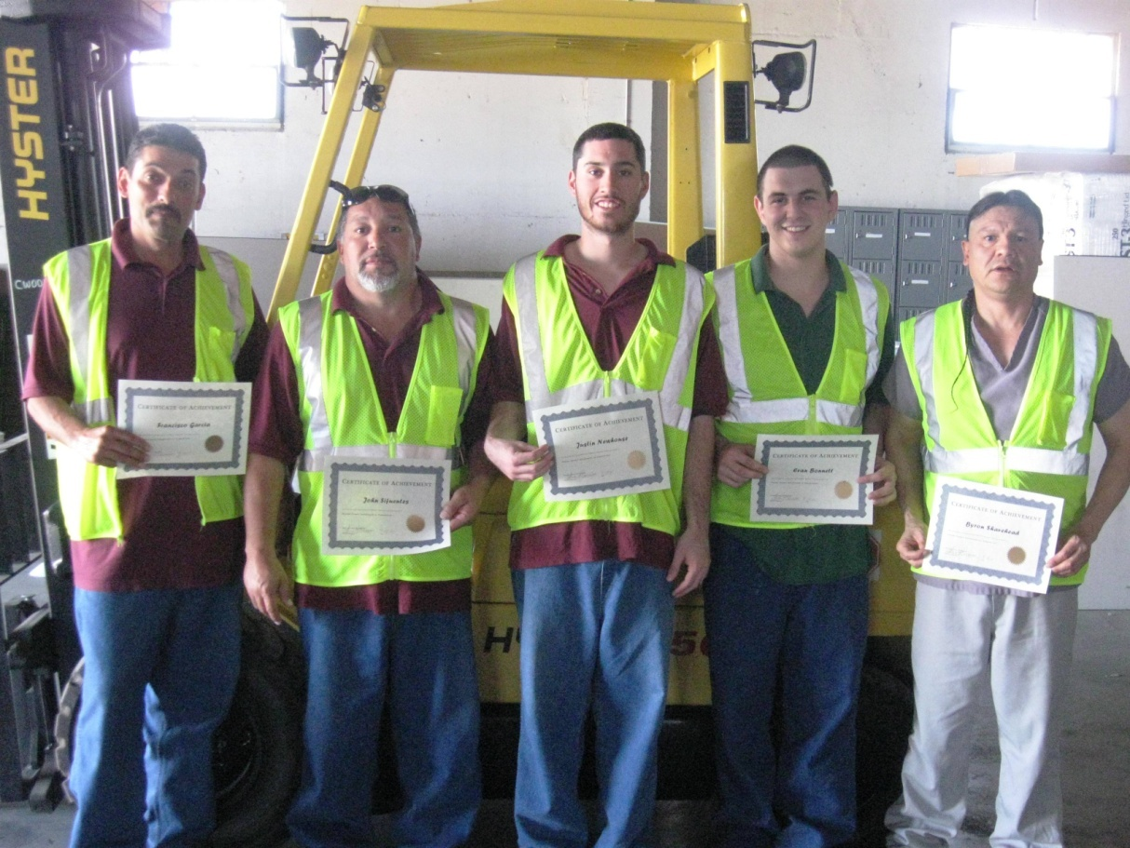
Inmate Programs Continued
Forklift Classes (Inmates must qualify to be an outside worker to take these classes)

Slide 18
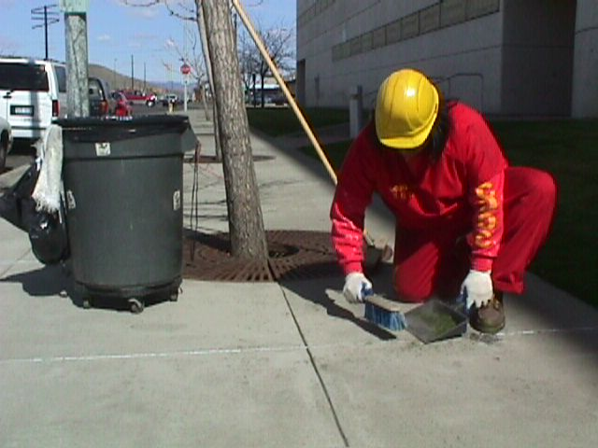
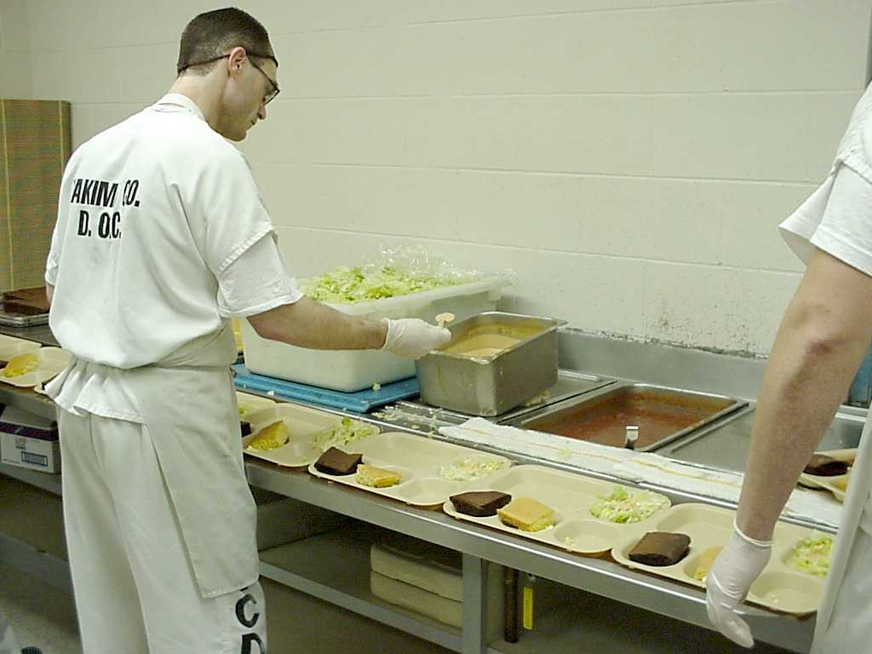
Inmate Programs Continued
Inmate Worker

Slide 19
Inmate Programs Continued
GED

Slide 20
Medical Services - ConMed
In house Doctor, Monday through Friday 0800 – 1500
Medical Clinic, Monday through Friday, 0800 – 1500
Free Annual Physical offered within 14 days of arrival
TB testing to all inmates
Pregnancy testing
On call Doctor, 24 hours a day, 7 days a week
Nurses available in house from 0400 – 2130 everyday for emergent response
In house lab draws
In house X ray
Medication administration 3 times daily
In house EKG
Wound Care
Glucose testing 3 times a day
Daily Segregation wellness checks
Intake Screenings of all inmates

Slide 21
Mental Health Services Provided
Mental Health Screenings
Mental Health Assessments
Psychiatric Medication Management Services (two two-hour medication management clinics per week)
Mental Health Case Management/ Therapeutic Services
On call doctor services (365 days a year, 24 hours a day)
Crisis and Critical Incident Services (24 hour access)
Sexual Assault and Crime Victim Services
Strong Families Parenting Classes

Slide 22
Additional benefits to housing prisoners in Yakima
Ability to track your inmates through Yakima’s Spillman system
Yakima Will Provide Video Visiting Equipment
Yakima Will Provide Mobile License for Public Defenders Office
Inmates families can access internet for inmate information
Families can access internet to place funds on inmate account

Slide 23
Construct a New Jail in Mount Vernon
Construct a 300 bed jail with a core support services to include (laundry/kitchen/etc.) expand to capacity of 400 at a later date.
The medium construction cost estimate for the 300 bed facility
is estimated at $60.5 Million, financed over 25 years at 4.25% interest, total bond (principle and interest) cost approximately
$90-95 Million.
The current operational costs for the jail is approximately $5.4 Million. The estimated operational cost for the new 300 bed jail
is $7.4 Million (a $2.0 million initial increase, will exceed $3.0 million over life of bond).

Slide 24
Skagit County Costs
Current Jail Construction Bond Project Estimate $60.5 million dollars
Total Bond Repayment over 25 years estimate $95 million dollars
Operating Costs Projected at $2 Million Annually (With adjusted 2.5% CPI cost will exceed $3 million dollars annually over life of Bond)
Bond and Operating Costs for New Jail Estimated over 12 years
est. $75 million Dollars
Bond and Operating Costs over 25 years est. $200+ million dollars

Slide 25
Projected Bed Rental & Transportation Cost Based on Seattle CPI Escalator
5 Year average Seattle CPI (2.056%)
# of Beds |  | 2013 | 2014 | 2015 | 2016 | 2017 | 2018 | 2019 | 2020 | 2021 | 2022 | 2023 | 2024 | 2025
1 - 50 |  | $60.00 | $60.00 | $61.23 | $62.49 | $63.78 | $65.09 | $66.43 | $67.79 | $69.19 | $70.61 | $72.06 | $73.54 | $75.05
51 - 100 |  | $59.00 | $59.00 | $60.21 | $61.45 | $62.71 | $64.00 | $65.32 | $66.66 | $68.03 | $69.43 | $70.86 | $72.32 | $73.80
101 - 150 |  | $58.00 | $58.00 | $59.19 | $60.41 | $61.65 | $62.92 | $64.21 | $65.53 | $66.88 | $68.26 | $69.66 | $71.09 | $72.55
151 + |  | $57.00 | $57.00 | $58.17 | $59.37 | $60.59 | $61.83 | $63.11 | $64.40 | $65.73 | $67.08 | $68.46 | $69.87 | $71.30
2012 Seattle CPI (2.6%)
# of Beds | 2013 |  | 2014 | 2015 | 2016 | 2017 | 2018 | 2019 | 2020 | 2021 | 2022 | 2023 | 2024 | 2025
1 – 50 | $60.00 |  | $60.00 | $61.56 | $63.16 | $64.80 | $66.49 | $68.22 | $69.99 | $71.81 | $73.68 | $75.59 | $77.56 | $79.57
51 – 100 | $59.00 |  | $59.00 | $60.53 | $62.11 | $63.72 | $65.38 | $67.08 | $68.82 | $70.61 | $72.45 | $74.33 | $76.27 | $78.25
101 – 150 | $58.00 |  | $58.00 | $59.51 | $61.06 | $62.64 | $64.27 | $65.94 | $67.66 | $69.42 | $71.22 | $73.07 | $74.97 | $76.92
151 + | $57.00 |  | $57.00 | $58.48 | $60.00 | $61.56 | $63.16 | $64.81 | $66.49 | $68.22 | $69.99 | $71.81 | $73.68 | $75.60
2.50%
# of Beds | 2013 |  | 2014 | 2015 | 2016 | 2017 | 2018 | 2019 | 2020 | 2021 | 2022 | 2023 | 2024 | 2025
1 - 50 | $60.00 |  | $60.00 | $61.50 | $63.04 | $64.61 | $66.23 | $67.88 | $69.58 | $71.32 | $73.10 | $74.93 | $76.81 | $78.73
51 - 100 | $59.00 |  | $59.00 | $60.48 | $61.99 | $63.54 | $65.12 | $66.75 | $68.42 | $70.13 | $71.89 | $73.68 | $75.52 | $77.41
101 - 150 | $58.00 |  | $58.00 | $59.45 | $60.94 | $62.46 | $64.02 | $65.62 | $67.26 | $68.94 | $70.67 | $72.43 | $74.24 | $76.10
151 + | $57.00 |  | $57.00 | $58.43 | $59.89 | $61.38 | $62.92 | $64.49 | $66.10 | $67.76 | $69.45 | $71.19 | $72.96 | $74.79

Slide 26
Bed Rental Comparison Yakima County & Skagit County
 | Yakima County |  |  | Skagit County |  |  | Saving
Year | Rate* | Revenue |  | Rate* | Revenue |  | Annual | Cumulative
2013 | $59.00 | $2,153,500 |  | $75.00 | $2,737,500 |  | $584,000 | $584,000
2014 | $59.00 | $2,153,500 |  | $75.00 | $2,737,500 |  | $584,000 | $1,168,000
2015 | $60.48 | $2,207,338 |  | $76.88 | $2,805,938 |  | $598,600 | $1,766,600
2016 | $61.99 | $2,262,521 |  | $78.80 | $2,876,086 |  | $613,565 | $2,380,165
2017 | $63.54 | $2,319,084 |  | $80.77 | $2,947,988 |  | $628,904 | $3,009,069
2018 | $65.12 | $2,377,061 |  | $82.79 | $3,021,688 |  | $644,627 | $3,653,696
2019 | $66.75 | $2,436,488 |  | $84.86 | $3,097,230 |  | $660,742 | $4,314,438
2020 | $68.42 | $2,497,400 |  | $86.98 | $3,174,661 |  | $677,261 | $4,991,699
2021 | $70.13 | $2,559,835 |  | $89.15 | $3,254,027 |  | $694,192 | $5,685,892
2022 | $71.89 | $2,623,831 |  | $91.38 | $3,335,378 |  | $711,547 | $6,397,439
2023 | $73.68 | $2,689,426 |  | $93.66 | $3,418,762 |  | $729,336 | $7,126,775
2024 | $75.52 | $2,756,662 |  | $96.01 | $3,504,231 |  | $747,569 | $7,874,344
2025 | $77.41 | $2,825,579 |  | $98.41 | $3,591,837 |  | $766,259 | $8,640,603
*2.5% growth and 100 beds

Slide 27
Yakima County Department of Corrections
 | Yakima County |  |  | Skagit County |  |  | Savings
Year | Rate* | Total |  | Rate** | Total |  | Annual | Cumulative
2013 | $59.00 | $2,153,500 |  | $101.03 | $3,687,595 |  | $1,534,095 | $1,534,095
2014 | $59.00 | $2,153,500 |  | $101.03 | $3,687,595 |  | $1,534,095 | $3,068,190
2015 | $60.48 | $2,207,338 |  | $102.91 | $3,756,033 |  | $1,548,695 | $4,616,885
2016 | $61.99 | $2,262,521 |  | $104.83 | $3,826,181 |  | $1,563,660 | $6,180,545
2017 | $63.54 | $2,319,084 |  | $106.80 | $3,898,083 |  | $1,578,999 | $7,759,544
2018 | $65.12 | $2,377,061 |  | $108.82 | $3,971,783 |  | $1,594,722 | $9,354,266
2019 | $66.75 | $2,436,488 |  | $110.89 | $4,047,325 |  | $1,610,837 | $10,965,103
2020 | $68.42 | $2,497,400 |  | $113.01 | $4,124,756 |  | $1,627,356 | $12,592,459
2021 | $70.13 | $2,559,835 |  | $115.18 | $4,204,122 |  | $1,644,287 | $14,236,747
2022 | $71.89 | $2,623,831 |  | $117.41 | $4,285,473 |  | $1,661,642 | $15,898,389
2023 | $73.68 | $2,689,426 |  | $119.69 | $4,368,857 |  | $1,679,431 | $17,577,820
2024 | $75.52 | $2,756,662 |  | $122.04 | $4,454,326 |  | $1,697,664 | $19,275,484
2025 | $77.41 | $2,825,579 |  | $124.44 | $4,541,932 |  | $1,716,354 | $20,991,838
*2.5% growth and 100 beds
** additional $26.03 debt service (400 beds) @ 300 beds = $34.70 add $8.67 (2m operating @400 beds = $13.70) (Does not include increase in Skagit DOC Operating)

Slide 28
Skagit County Costs
Current Jail Construction Bond Project Estimate $60.5 million dollars
Total Bond Repayment over 25 years estimate $95 million dollars
Operating Costs Projected at $2 Million Annually (With adjusted 2.5% CPI will exceed over bond repayment $3 million dollars annually)
Bond and Operating Costs for New Jail Estimated over 12 years $75 million Dollars
Bond and Operating Costs over 25 years est. $175 million dollars
Cost to House (100) Inmates in Yakima County over 12 years

Slide 29
Yakima County Department of Corrections
Yakima County can provide:
Bed Space up to 450 inmates
Transportation (Can return an inmate to Skagit in 1 to 3 days)
Video Visiting
Video Conferencing for Assigned Counsel
In-House Medical Care
In-House Mental Health
Inmate Programs
Customer Service Oriented (We will try to accommodate all Requests)

Slide 30
Skagit County Identified Issues
Security – Safety “Crowding at the jail has reached dangerous levels”
Crowding and remote supervision have had a negative impact
Too many inmates for:
The space
The staff
Inmates have too much time on their hands
Lack of consequences
Lack of accountability
Visitation – “Labor Intensive/ Control Issues”
Security Control “Poor Cameras, Inefficient lay-out”
Health Care “Not designed for today’s Health Care issues”

Slide 31
Key Issues
Skagit County population will increase significantly in the next 20 years.
Crowding at the jail has reached dangerous levels.
The long-term population includes two groups
Long-term pretrial detainees with complex cases and high risk behaviors.
Sentenced inmates who have failed in alternatives and have significant substance abuse issues.
Criminal justice agencies are all impacted by increased workload.
The jail’s physical plant was not designed to support the current population.
Expansion and flexibility in the solution is essential to avoid repetition of the current situation in the future.

Slide 32
Questions???

